Slide 1
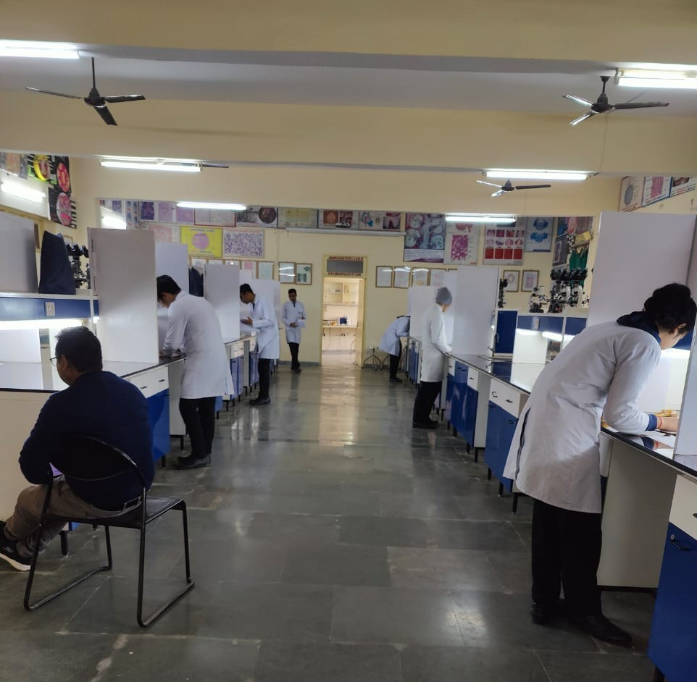
OSPE- ASSESSMENT OF PRACTICAL SKILLS
Dr. Shweta Singh
Professor &Head
Department of Anatomy
HIMS, Safedabad

Slide 2
Learning objectives
Understand the role and place of assessment(OSPE) in new competency based
curriculum
Plan, develop and implement CBA(OSPE) in the colleges.

Slide 3
KNOW THE TERMS- OSPE AND CBA
The objective structured practical examination
(OSPE) was modified from Objective Structured Clinical Examination (OSCE) in the 1970s(Harden and Cairncross, 1980)
CBA is Competency Based Assessment
based on direct observation and therefore helps in generation of authentic assessment
feedback, which helps the students to learn better.
assessment for learning is crucial for the acquisition of competencies.

Slide 4
A SHIFT FROM TRADITIONAL PARADIGM TO MOREN PARADIGM
TRADITIONAL ASSESSMENT easy to design, administer, score and analyse snap shot observations of Learning not linked to instructions or outcomes and promote test taking behaviour. They are fragmented and mainly focus on knowledge | COMPETENCY BASED ASSESSMENT more comprehensive information about not only the current stage of the student but also about his progression and ascendency low stakes and help to reduce examination anxiety based on direct observation and therefore helps in generation of authentic feedback

Slide 5
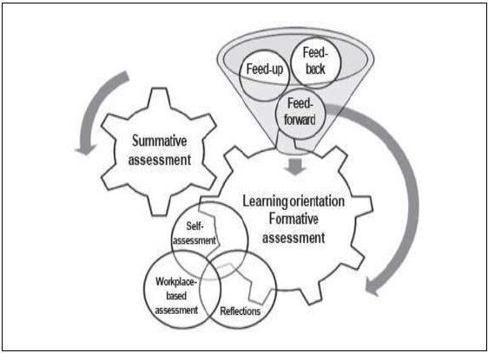
Paradigm of medical student assessment

Slide 6
Assessment methods as per levels of competency

Slide 7
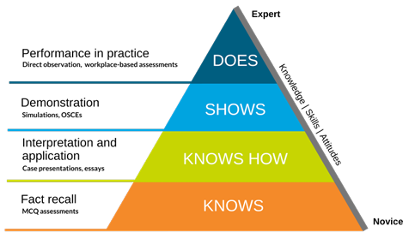
The concept of Miller's Pyramid was introduced by George E. Miller in 1990. It was specifically designed to assess clinical competence in medical education, emphasizing the progression from knowledge acquisition to real-world application.

Slide 8
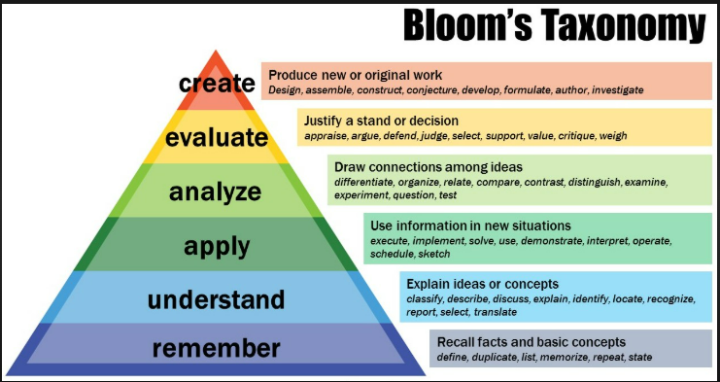
Bloom's Taxonomy, on the other hand, was developed by Benjamin Bloom and his collaborators in 1956. It provides a hierarchical framework for cognitive learning, widely used across various educational fields

Slide 9
Assessment opportunities
Formative assessment
ongoing assessments
conducted by the teachers teaching the subject and can be both formal and informal.
the primary purpose is providing feedback for improving learning
Summative assessment
used for pass or fail decision
to sample the learning and ensure quality.
IA is when assessment is done by the teachers who have taught the subject.
It overcomes the limitations of day-to-day variability
allows larger sampling of topics, competencies and skills.

Slide 10
IA focuses on the content and process of learning
It should involve all faculty members of a department
IA can be further improved by involving all teachers in the department and limiting the contribution of individual teacher, test or tool
A blueprint maybe needed to decide which competencies should be assessed during internal assessment and which should go to summative or University examinations

Slide 11
Factors which help to improve the reliability and validity of assessment are the use of
Multiple methods used by
Multiple examiners in
Multiple settings to assess
Multiple competencies,
Blueprinting and
Longitudinal assessment

Slide 12
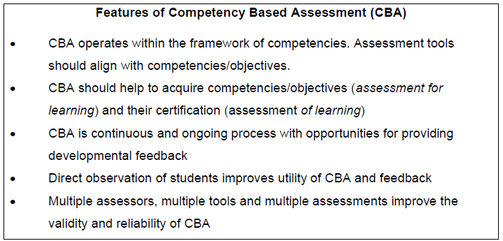

Slide 13
Attributes of an effective assessment
Validity
Reliability
Fairness/transperancy
Relevance
Feasibility
Adaptibility
comprehensive

Slide 14
Threats to these Attributes
Construct underrepresentation
Too few items
Low reliability
Low generalibility
Too few independent raters
Construct irrelevant variance
Flawed items
Biased items/inappropriate difficulty level
Cheating/ teaching to the test
Halo effect/ leniency/central tendency

Slide 15
Blueprint is a map and a specification for an assessment program which ensures that all aspects of the curriculum and educational domains are covered by assessment programs over a specified period of time.

Slide 16
How to determine the assessment scheme
Laid out by the university for summative assessment
all levels of knowledge domain
Use appropriate verbs for the questions at each level to assess higher levels of learning.
Use combination of various types of questions e.g. LAQ,SAQ, MCQ.
Marks for each part should be indicated separately.
The question paper setter must sample the contents appropriately from competencies.

Slide 17
CAN YOU WRITE THE SCHEME FOR PRACTICAL ASSESSMENT IN YOUR DEPARTMENT IN INTERNAL ASSESSMENT?

Slide 18
Scheme for Practical examination for PC practical in IA practical in Anatomy (50 marks)
OSPE – 10 non observed stations and 2 observed station carrying 2.5 marks each(25 marks)
Gross practical(6 marks)
Histology practical( 5 marks)
Osteology viva(6 marks)
Embryology viva(3 marks)
Radiology viva(3marks)
Surface marking viva(2 marks)

Slide 19
Formative assessment on the topic of thorax
Theory(50 marks) and Practical(50 marks)
Topics as per NMC- Topics 21-25 in the CBME curriculum(11+7+6+6+9) competencies
Thoracic cage Heart and pericardium Mediastinum Lung and trachea Histology of lung ,trachea and heart Development and related anomalies of lung and CVS Osteology of thorax Radiology of thorax Surface marking of thorax

Slide 20
Structuring of OSPE in practical Assessment
OSPE stations(12)(25marks)
Non observed Stations(10)(2marks each)
Observed stations(2) with observers and checklists(2.5marks each)
One each for Histology, AETCOM, ECE, Embryology, Radiology,
One Observed stations for osteology
One Observed stations for embryology/gross
Two to three each for Gross and Osteology,

Slide 21
Weightage(W)= Impact(I) × Frequency(F)
Perceived Impact/ importance of topic
Non urgent, little prevention potential- 1
Serious but not urgent- 2
Life threatening- 3
Frequency of occurrence of condition
Rarely seen- 1
Relatively common- 2
Very common- 3

Slide 22
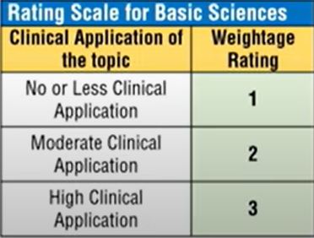

Slide 23
Sl.no | Topic | Impact | Frequency | I*F | Combined weightage | Percentage weightage
1 | Thoracic Cage | 3 | 2 | 6 | .09 | 9
2 | Heart &Pericardium | 3 | 3 | 9 | .14 | 14
3 | Mediastinum | 2 | 2 | 4 | .07 | 7
4 | Lung &Trachea | 3 | 3 | 9 | .14 | 14
5 | Histology of Lung &Trachea | 2 | 2 | 4 | .07 | 7
6 | Embryology of Respiratory system and CVS | 2 | 2 | 4 | .07 | 7
7 | Osteology of Thorax | 3 | 3 | 9 | .14 | 14
8 | Surface marking of thorax | 3 | 3 | 9 | .14 | 14
9 | Radiology Of Thorax | 3 | 3 | 9 | .14 | 14
10 |  |  |  | 63 | I*F/SUM(63)=1 | 100

Slide 24
Sl.No | Topic | Recall(50%) | Comprehension(25%) | Application(25%)
1 | Thoracic Cage | 4.5 | 2.25 | 2.25
2 | Heart &Pericardium | 7 | 3.5 | 3.5
3 | Mediastinum | 3.5 | 1.75 | 1.75
4 | Lung &Trachea | 7 | 3.5 | 3.5
5 | Histology of Lung &Trachea | 3.5 | 1.75 | 1.75
6 | Embryology of Respiratory system and CVS | 3.5 | 1.75 | 1.75
7 | Osteology of Thorax | 7 | 3.5 | 3.5
8 | Surface marking of thorax | 7 | 3.5 | 3.5
9 | Radiology Of Thorax | 7 | 3.5 | 3.5
10 |  | 50 | 25 | 25

Slide 25
Scheme for Practical examination for PC practical in t for IA practical in Anatomy (50 marks)
OSPE – 10 non observed stations and 2 observed station carrying 2.5 marks each(25 marks)
Gross practical(6 marks)
Histology practical( 5 marks)
Osteology viva(6 marks)
Embryology viva(3 marks)
Radiology viva(3marks)
Surface marking viva(2 marks)

Slide 26
An objective exam because it is based on using the same stations and the same assessment checklist in the student evaluation to enable the student to get marks for every performed step
A structured exam because it depends on providing the designed specific tasks that cover all curriculums for all students with specific instructions.
The validity of OSCE includes content validity “a good sampling of matching skills with the learning outcomes
Reliability measures the consistency of OSCE. Detailed checklists in OSCE may decrease inter-rater unreliability as results depend on the direct observation .

Slide 27
Structuring of OSPE in practical Assessment
OSPE stations(12)(25marks)
Non observed Stations(10)(2marks each)
Observed stations(2) with observers and checklists(2.5marks each)
One each for Histology, AETCOM, ECE, Embryology, Radiology,
One Observed stations for osteology
One Observed stations for embryology/gross/
surface marking
Two to three each for Gross and Osteology,

Slide 28
The Venue, resources setting and timing .

Slide 29
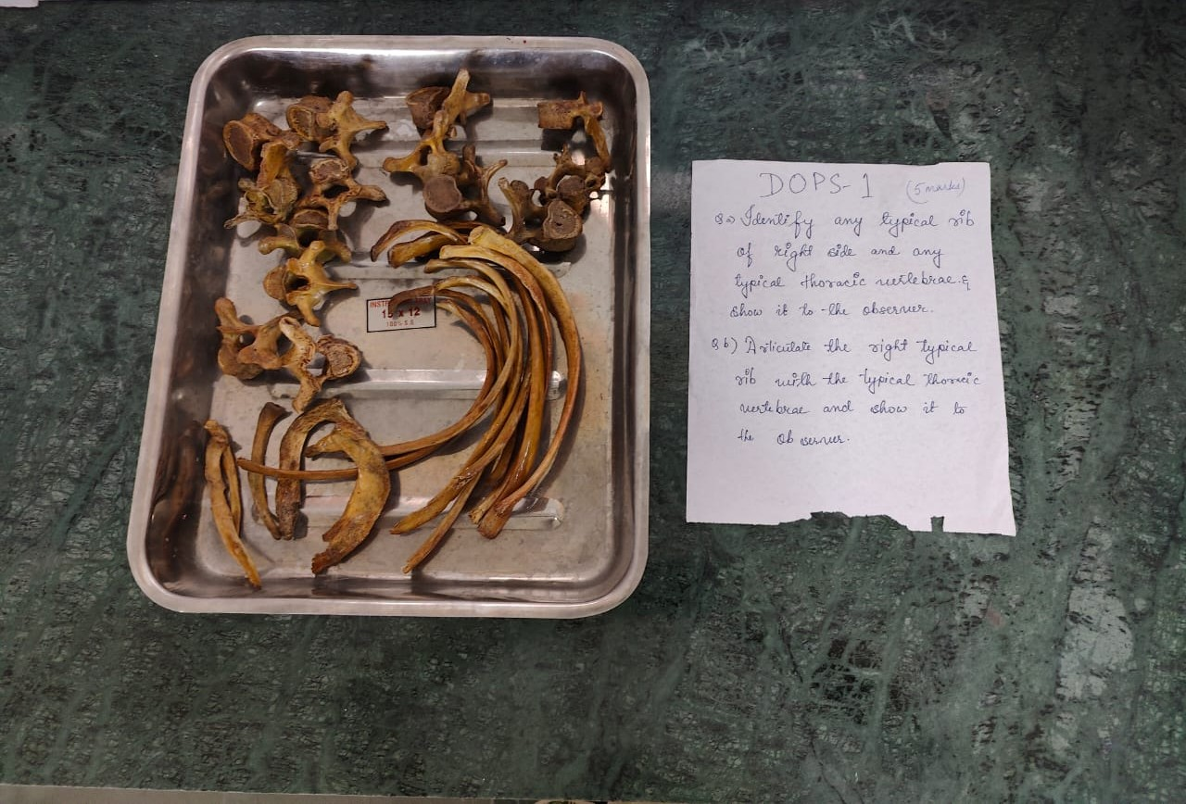
The Station,materials required, instruction and marks.

Slide 30
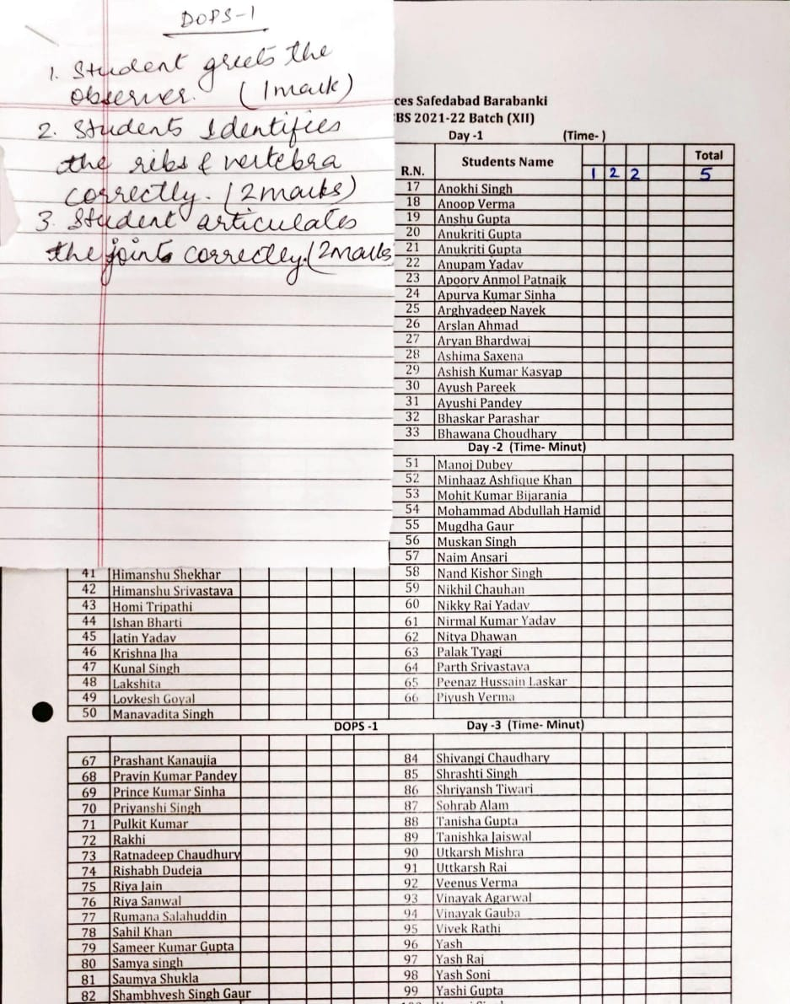
The Check List and Marking sheet

Slide 31
Planning, Designing and Implementation
Committee for the designing to implementation stage
Designing a blueprint
The Blueprint should translate into definite skills, behaviors, and attitudes that will be assessed by the examiners based on the learning objectives
The stations of OSPE and its number should be determined (10-12 at least)
The scoring criteria of the assessment should be prepared for every station

Slide 32
Implementing
Logistic procedures(venue/Resources/time/quarantine)
Outline the required task , the marking scheme, instructions about the action and performance of the student at every station
Instructions of examiners
Instructions of the students

Slide 33
Implementing
Instructions is considered essential for the examiner and student
Outline the required task exactly at every station for the student and outline the marking scheme instructions about the action and performance of the student at every station
Instructions of examiners should be simple and sharp - such as put the student at ease, observe the performance of the student and interact with him without chatting and do not give the student any feedback
Instructions of the student should also be clear,
In the related context, it should also evaluate the exam after finishing it to detect mistakes and work to avoid them in the future.
"Student can perform it", pilot the duration of the station” it should be deciding the duration of the station before the exam,

Slide 34
After the OSPE
Collect the responses for correction from the students.
Collect the marking sheet from examiners/observers
Display the correct responses to the task at each OSPE
Give feedback to the Students regarding their performance
Collect feedback from students and observers regarding the OSPE

Slide 35
ON the Next Day(or later)
Analyze Performance Data:
Review Station Effectiveness.
Debrief with Examiners.
Document Observations.
Update Question Bank.
Communicate Results.
Plan Remedial Sessions.
Reflect on Logistics.

Slide 36
WORKSHOP
Choose a competency from your competency table given by NMC and Make an OSPE station pertaining to your branch

