Slide 1
INTRODUCTION TO OSPE, OSCE
AND OSLER
Dr. Shambhavi Tripathi
Professor
Dept of Pathology

Slide 2
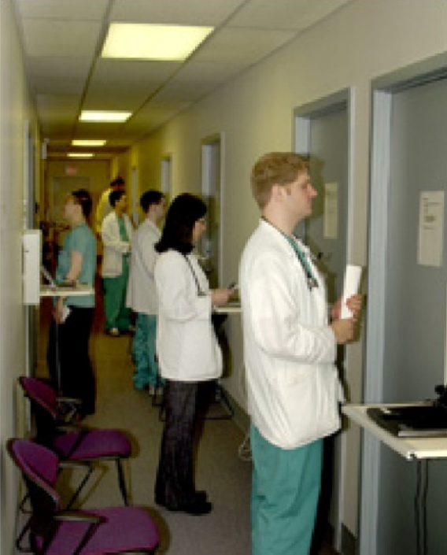
objective structured PRACTICAL examination (OSPE)

Slide 3

Introduction
The term OSPE is derived from OSCE in 1975 which was later extended to practical examination and modified by Harden and Gleeson.
A multi station, multi task process of assessment

Slide 4
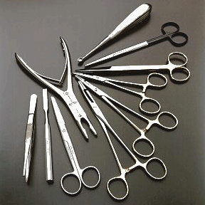
Definition
Objective structured practical examination (OSPE) is a new pattern of practical examination, in which each component of clinical competence is tested uniformly and objectively for all the students who are taking up a practical examination at a given place.

Slide 5

Features of OSPE
The main features of OSPE is that the process and the product are tested giving importance to individual competencies.
The examination covers a broad range of clinical skills.
The scoring is objective, since standards of competence are present and agreed check lists are used for scoring.

Slide 6
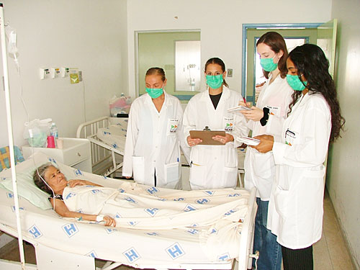
Where questions are asked in response station. There is scope for immediate feedback.
Patient variability and examiner variability are eliminated thus increasing the validity of the examination.

Slide 7
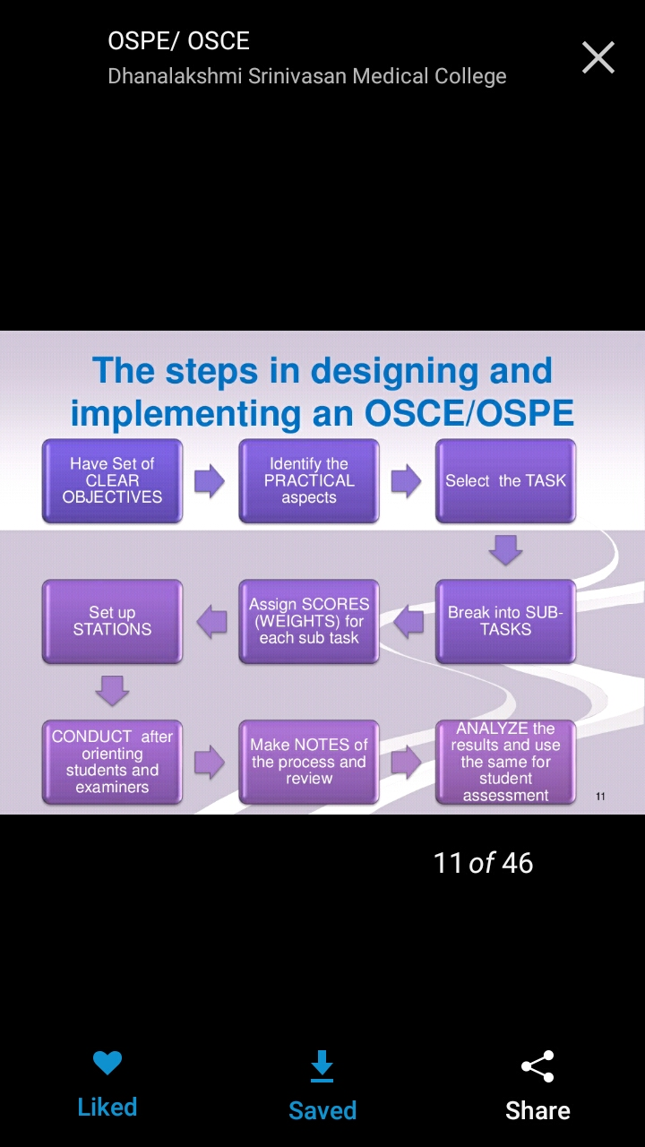

Slide 8
Movement in the Stations
1
2
3
4
5

Slide 9

Explanation of procedure and response station by example.

Slide 10

Advantages of OSPE
1. It is useful for any subject.
2. It can also examine both the clinical and Experimental skills.
3. Checklists are used for marking and evaluation.
4. Student take more interest due to verity and keep themselves alert during the whole process.
5. Large no of students can be tested with in the short time.

Slide 11

Disadvantages of OSPE
1. If proper planning, briefing to the student, preparation of procedure of response stations are not done properly then the whole process of OSPE may become failed.
2. Separate observer for each station is required.

Slide 12

OBJECTIVE STRUCTURE
CLINICAL EXAMINATION (OSCE)

Slide 13
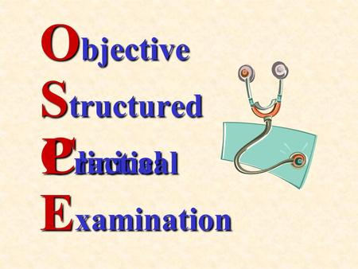

Slide 14
INTRODUCTION:
An OSCE is a modern type of examination often used in medical sciences to test clinical skill performance and competence in skills such as communication, clinical examination, medical procedures, prescription, etc and interpretation of result.

Slide 15
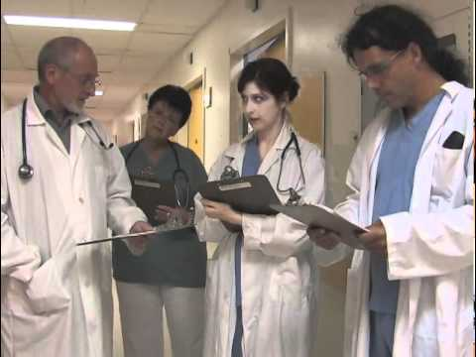
OSCE DESIGN:
Objective – all candidates are presented with the same stimuli

Slide 16
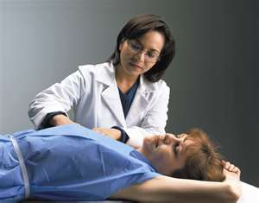
What is an OSCE?
Objective
Structured – Specific foundational and functional competencies are tested at each station and the marking sachem for each station is structured

Slide 17
What is an OSCE?
Objective
Structured
Clinical Examination – Test of performance of clinical competencies, with an emphasis on skills and attitudes

Slide 18
Objective
All candidates are assessed using exactly the same stations with the same marking scheme.
In an OSCE candidates get marks for each step on the mark scheme that they perform correctly
which therefore makes the assessment of clinical skills more objective rather than subjective.

Slide 19
METHOD & STATION : TWO TYPES
EXAMINER
OBSERVES
PROCEDURE STATION
e.g. Taking history of a patient
Examine this patient’s pulse
STUDENT ANSWERS ON
THE ANSWER SHEET
QUESTION STATION
MCQs related to finding
Interpretation of temperature chart

Slide 20
        Features of OSCE
The main features of OSCE/OSPE is that both the process and the product are tested giving importance to individual competencies.
The examination covers a broad range of clinical skills.
The scoring is objective, since agreed check lists are used for scoring.
Patient variability and examiner variability are eliminated thus increasing the validity of the examination.

Slide 21






Measuring Clinical (Behavioral) Skills
Observation of professional practice
Professional behaviour
Does
Shows how
OSCE
Knows how
MCQ, MEQ,
Essay
Knows
MCQ, SAQ
Miller GE. The assessment of clinical skills/competence/performance. Academic Medicine (Supplement) 1990; 65: S63-S67.

Slide 22
Advantages of OSCE
Students were appraised about their performance.
It also highlighted the need for clinical supervision.
The students were evaluated on objectives in clinical competence based on set criteria.
It gave the faculty the opportunity to differentiate the high with the low performance objectively.

Slide 23
DISADVANTAGES
Knowledge and skills tested in COMPARTMENTS, not for ability to look at the patient as a whole.
DEMANDING for examiners and patients – use more patients/ simulated patient.
TIME taken for planning in advance greater than traditional examination.
More effort and time are required before examination.

Slide 24
OSLER:
The Objective Structured Long Examination Record (OSLER) is a 10-item assessment tool used in medical education to evaluate clinical competence, particularly in long case examinations.
It aims to improve the objectivity, validity, and reliability of traditional long case assessments by providing a structured and analytical record.
OSLER focuses on key areas like history-taking, physical examination, presentation, investigations, management, and clinical acumen

Slide 25
Purpose:
The OSLER aims to standardize the assessment of clinical skills in a long case format, making it more objective and reliable than traditional methods.

Slide 26
Components:
The 10-item record covers various aspects of the long case, including:
○ Pace and clarity of presentation
○ Communication process
○ Systematic approach
○ Establishment of case facts
○ Systematic examination

Slide 27
○ Examination technique
Establishment of correct physical findings
Formulation of appropriate investigations
Formulation of appropriate treatment
Clinical acumen: Assesses the student's overall clinical reasoning and judgment.

Slide 28
Benefits:
By providing a structured and analytical record, OSLER helps improve the objectivity and reliability of long case assessments.
It is a valuable tool for assessing clinical competence and identifying areas where students may need further development

Slide 29


