Slide 1
OSLER The Objective Structured Long Examination Record (OSLER)
Uma Gupta
MD(OBG)
FAIMER Fellow 2012
Bioethics Trained(UNESCO Chair)
MHPE(2019)

Slide 2
LONG CASES
????
>20 years long cases
Criticism ?
Different cases, easy /difficult.
Referred as “LUCK OF DRAW”

Slide 3
CASE ALLOTTMENT:
The students pick up a chit, lottery fashion, to know which case they have to do. The lucky ones may get an easier while the unlucky ones may land up with a tough case.
After finishing the case the student waits for the examiner who cursorily listens the history and shoots a few questions sometimes relevant to the
case and at other times more general
or theoretical.

Slide 4
The encounter lasts a short time and the judgement is passed. The student's score in this practical examination
thus gets highly influenced by his luck due to the mode of allotment of the exercises and the whims, fancies and mood of the examiner.

Slide 5
Drawbacks
PRODUCT is assessed and not the PROCESS
Is history taking assessed?? So no valid assessment
Belief is History taking essential skill for diagnosis

Slide 6
History
The Objective Structured Long Examination Record (OSLER)
OSLER was introduced by Gleeson in 1992
What is “the OSLER”?
An attempt to remodel and improve the long case examination
He suggested modifications to improve the long case examination

Slide 7
OSLER..
The long case is divided into 10 items on which each candidate is assessed
The 10 items cover all aspects of working up a long case
The process of history taking, examination and management of the patients is observed
In addition to observation during history taking, communication skills are also evaluated

Slide 8
10 items in OSLER
History taking
1. Pace and clarity of presentation
2. Communication process
3. Systematic approach
4. Establishment of case facts
Physical examination
1. Systematic approach
2. Examination technique
3. Establishment of correct findings
Management
1. Appropriate investigations in logical sequence
2. Appropriate management plan
3. Clinical acumen

Slide 9
History taking
1. Pace and clarity of presentation
2. Communication process
3. Systematic approach .
4. Establishment of case facts

Slide 10
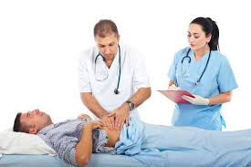
Physical examination
1. Systematic approach
2. Examination technique
3. Establishment of correct findings

Slide 11
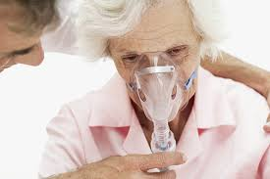
Management
1. Appropriate investigations in logical sequence
2. Appropriate management plan
3. Clinical acumen

Slide 12
OSLER …….
All candidates will be assessed on same 10 items by the examiners in the same frame
Grades:
P+ (very good/ excellent)
P (pass)
P- (below pass)
Examiners and co –examiners analyze and give overall grade

Slide 13
In conventional examination marks awarded is on candidates global performances not for individual competencies
The OSCE is a highly reliable and valid clinical examination that provides unique information about the performance of residents

Slide 14
Unlike OSCEs,
this form of assessment is over a longer period of time (total of 45 minutes per case).
It is a thorough assessment of the students’ history and examination skills, as well as their ability to present back findings, formulate a differential diagnosis and subsequent management plan. The student’s communication skills are assessed during the last part of the examination.

Slide 15
OSLER examination is made up of three 15 minutes
Time 0 to 15 minutes (15 minutes) | History and examination
Time 15 to 30 minutes (15 minutes) | Thinking time
Time 30 to 45 minutes (15 minutes) | Summary, management and explanation

Slide 16
Part 1: History and examination
At the start of the exam you will be given an opening statement by the examiners e.g. “Please take a history from Mrs X who is under the cardiology team”
You then have 10 minutes to take a history from the patient.
On finishing your history, or after 10 minutes, the examiners will then ask the following questions:
“What is/ are the most likely cause(s) for this patient’s presentation?”
“What examination would you like to carry out, and why?”

Slide 17
Importance of History Taking
Obtaining an accurate history is the critical first step in determining the etiology of problem.
A large percentage (70%) , you will actually be able make a diagnosis based on the history alone.
How to take a history?
questions that help define the nature of a particular problem.

Slide 18
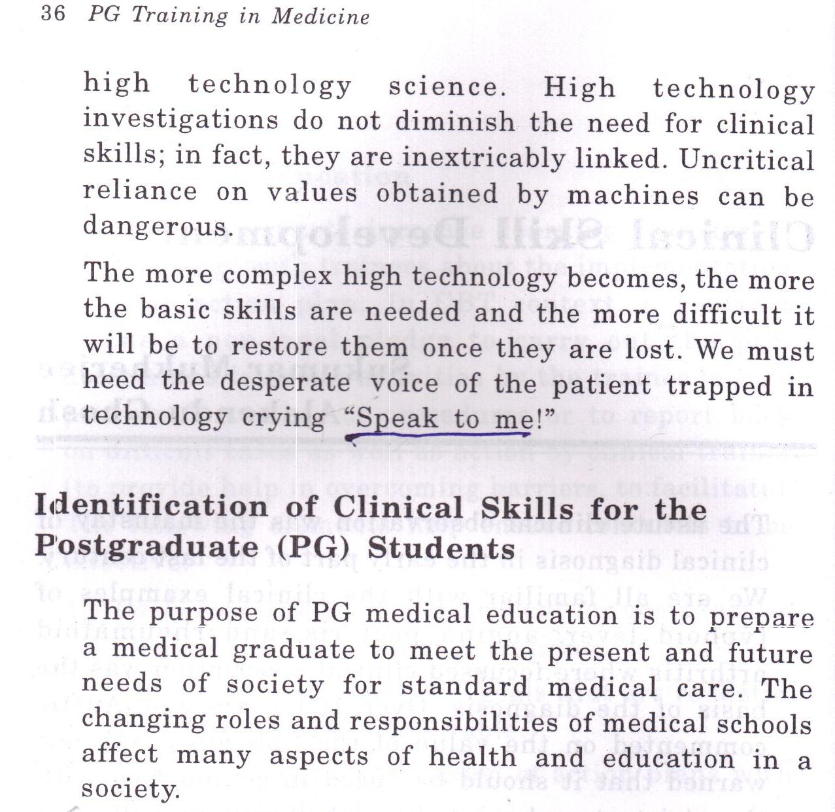
We must heed desperate voice of patient trapped in technology crying “SPEAK TO ME”.

Slide 19
Pace/Clarity essentially assesses communication between the candidate and the examiner.
Pace of presentation measures rate of speech with appropriate pauses.
Too rapid and it is unintelligible, too slow and it is inefficient in terms of time economics.
Clarity is obviously allied to pace but at the same time recognizes the need and ease with which the examiner observes the unfolding story that is the history.
Greater emphasis is now being placed on communication skills in medical schools (GMC, 1993)

Slide 20
At this point,
you will perform the relevant examination for the patient.
This will last 5 minutes.
The examiner will either interrupt you, or you would have naturally finished the examination, before you are moved on to the next part of the exam.

Slide 21
Part 2: Thinking time
You will be taken to a separate quiet area for your thinking time.
Use this time to summarise your notes on your history & examination findings, as well as prepare your investigations and management plan.
The examiners will ask you about this in the next part so make sure you spend enough time on this.
The thinking time is a good opportunity for you to start anticipating questions that may be asked surrounding the patient’s diagnosis. Write down some facts around the topic (epidemiology, pathophysiology…).

Slide 22
Part 3: Summary, management and explanation
On returning to the examination room you will be asked the following questions (10 minutes):
“Summarise the relevant positive findings from your history and examination” Present the case to the examiners using the Four Point Presentation structure Your summary should be no longer than 2 minutes. DO NOT repeat the entire history. Conclude your summary by stating your top 3 differential diagnoses for the patient.
“What do you think are the patient’s main problems and why?” Structure your answer using the Bio-Psycho-Social approach

Slide 23
“What investigations would you do and why?” Structure your order of investigations with Bedside, Bloods, Imaging and Special tests. Make sure you give a justification for each.
“How would you treat this patient?” Start your answer with “I would treat this patient with an MDT approach”, then name the MDT personnel you would involve. Structure your answer using the Conservative, Medical, Surgical approach. Consider how you would manage the patient if they presented acutely or in crisis as a complication of their disease or treatment. If this is asked of you, explain your management plan using ABCDE.

Slide 24
Examiners assess the candidate's ability to construct appropriate investigations for the case in question in a logical sequence.
Frequently, appropriate investigations might be suggested but the sequence would be inappropriate either in terms of invasiveness of the patient or in terms of costs.
assess the candidate's ability to logically sequence her thought processes in a limited time. This is an additional skill which is essential for later efficient practice.

Slide 25
You will be asked additional questions on pathology, physiology, anatomy, pharmacology etc which are relevant to the case.
In the final 5 minutes of the examination you will be assessed on your communication skills.

Slide 26
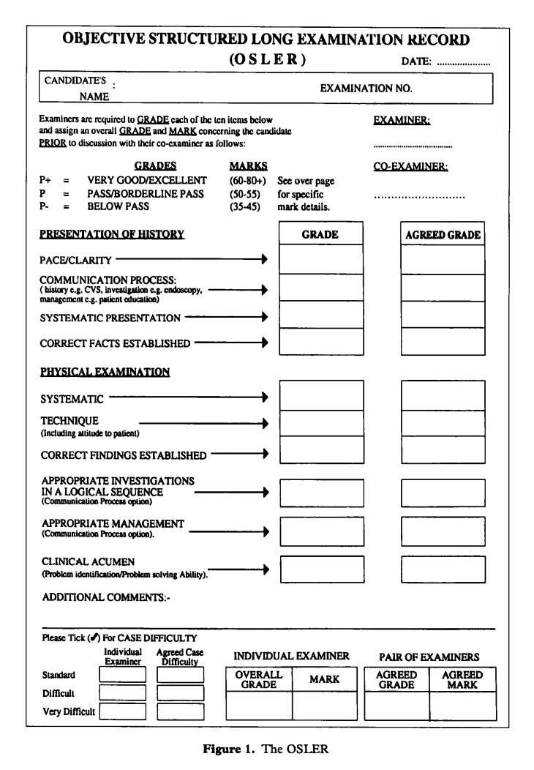

Slide 27
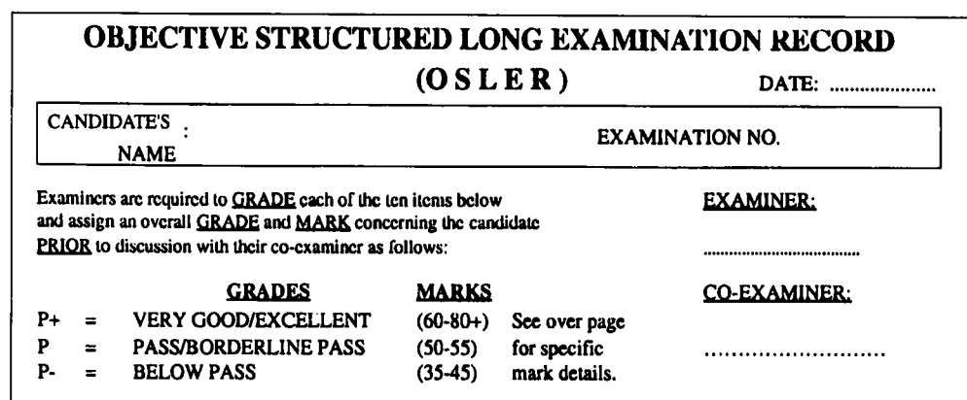

Slide 30
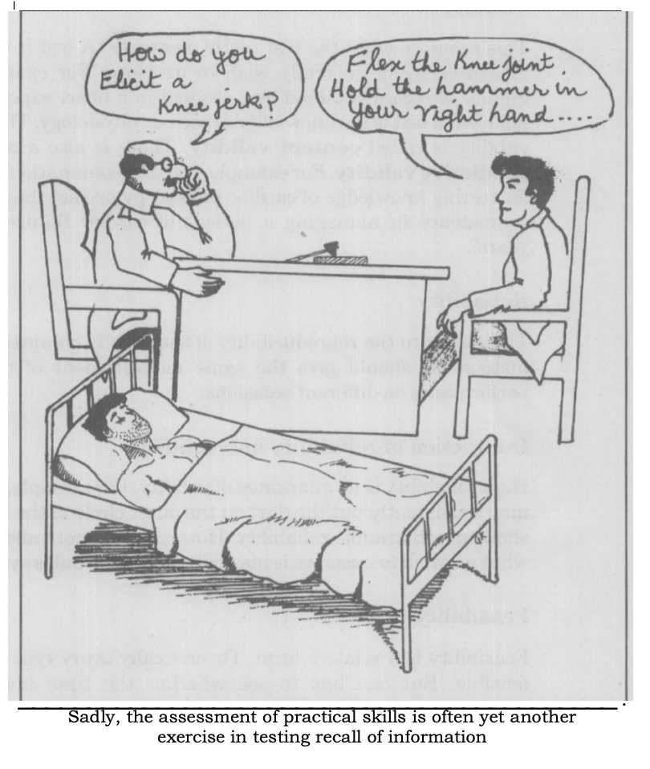
Right skill for right domain
??

Slide 33
CASE Difficulty
The case difficulty has been arbitrarily divided into ‘standard cases’, which would represent a single problem,
‘Difficult’ cases, which would include up to three problems
and ‘very difficult’ cases, with greater than three problems.
It will be appreciated that a single problem could amount to a very difficult case

Slide 34
GRADES and MARKS

Slide 35
OSLER …….
Grades:
P+ (very good/ excellent)
P (pass)
P- (below pass)
Examiners and coexaminers analyze and give overall grade

Slide 36
 | 80. Outstanding, clear, factual correct history taking Demonstrating physical signs, organized clear management, outstanding communication skills and clinical acumen
P+ | 75. Excellent case presentation , communication skills, examination technique, Demonstration of correct factsc and clinical signs of case. Display outstanding attrlbutes in some but not all measurable .
 | 70. Excellent in most skills. Examinalion technique and demonstratin of correct facts and physical signs of the case; Also excellent communicator and demonstrates ability to investigate and appropriately manage patient.
 | 65, Very good overall. major parts covered but few omissions, Clearly above average in terms of communication and clincal acumen
 | 60 very good in most respect in presentation and communication, but not in all aspects, well developed acumen

Slide 37
P | 55: Good overall and communication of the case wilhout displaying any attriibutes out of the ordinary. The candidate displays overall adequate slandered of examination patient. problems arc idenlitied and a reasonable management
 | 50: Adequate presentation of the case & communication abillty. Nolhing suggest more than just reaching an acceptable diagnosis. Clinical acumen just repching an acccptable standard Safe border line candidate who just reaches pass standard

Slide 38
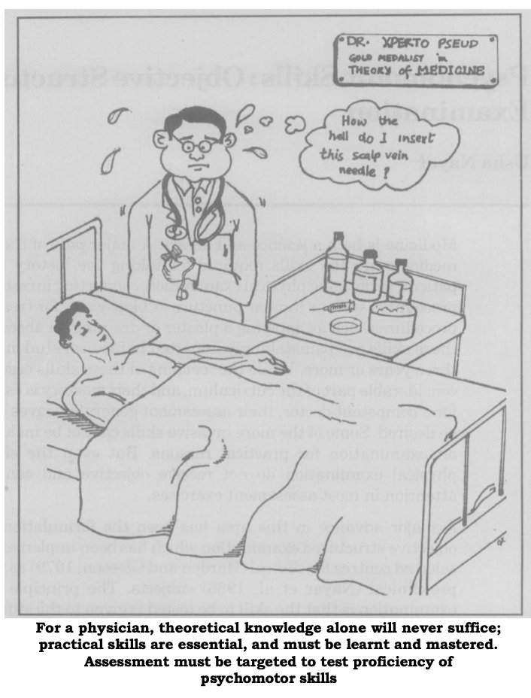
Qualified
NOT COMPETENT

Slide 39
P- | 45:Poor performance in terms of case presentation, communication with the patient. Demonstration of physical signs poor, inadequate unacceptable at level of understanding patient’s problems. Does not reach pass standard.
 | 30 : Veto mark. The candidate’s performance in terms of case presentation, clinical exam communication skills is so poor that he remotely approached the diagnosis. Quite clearly this candidate needs further training.

Slide 40
Attributes of a Good Assessment of Clinical Competence
Clinical competence consists of proficiency in a number of areas.
These include: history taking, physical examination, interpretation of findings, differential diagnosis, planning investigations, planning and institution of therapy, conducting procedures, prognostication, communication skills, appropriate attitudes, skills in organization/ management and ability to work as a team.
These elements demand a high order of cognitive, psychomotor and attitudinal attributes. A good assessment of clinical competence should aim at assessing all these abilities

Slide 42
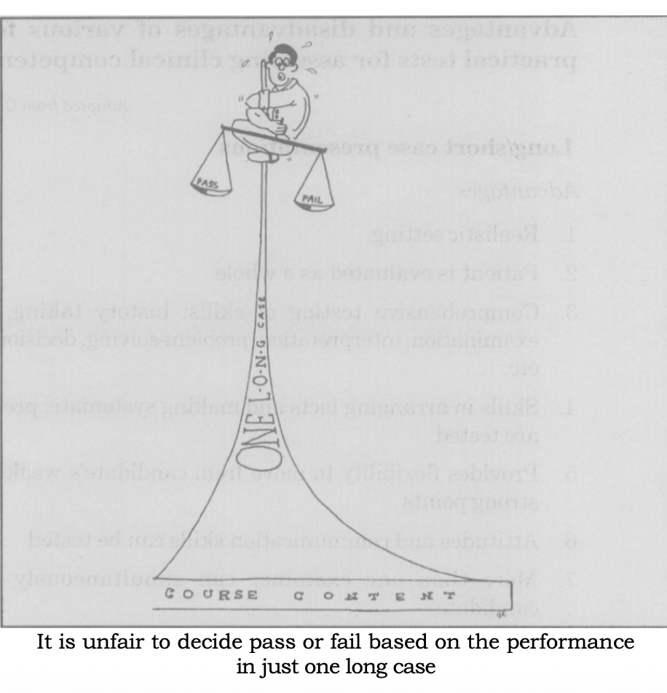
THANKS

