Slide 1
Designing and Standardising Research Tools: Interview & Questionnaire
Presented By
Dr. Richa Rathoria
Professor & Head, Department of Obs & Gynae
HIMS Ataria Sitapur

Slide 2
Information Collected With Data Collection Tools
Generally, in health research, the kind of information that we would like to collect can be basically divided into three areas.
1. We want to know facts such as, the characteristics of our study participants, the environment that they live in and their behaviors or practices.

Slide 3
Information Collected With Data Collection Tools
2. Secondly, we might want to know their level of knowledge for things such as, risk factors for getting disease or knowledge about healthy lifestyle, so as to prevent diseases

Slide 4
Information Collected With Data Collection Tools
3. Thirdly and very importantly, we might want to collect information on what we call the domain of judgments, basically what are the opinions of the research participants on a certain issue, may be such as quality of health services.

Slide 5
Different tools to collect data
1. Abstraction forms, which is basically doing a review of records of the study participants, which could be their personal records, the forms. If you want to get information on their disease conditions, signs and symptoms, a treatment given, then we could look at the clinical records. We could look at data in general, the data that is collected through disease surveillance, and we could also look at registers, wherein some information, which may be there, and all of this information can be culled out into what we want, in the form of a data abstraction form.

Slide 6
Different tools to collect data
2. Structured Observation Guide: This is very useful when we would like to document certain processes, whether they are happening, the way they are happening, that they are happening in time or not, are the objectives met and for this purpose we may use a check list of items that we would like to collect data on which could be the textual or figurative.

Slide 7
Different tools to collect data
3. Questionnaire: It is the most commonly used tool, in which we would like to talk to the person and get information. It can be of two kinds:
Interviewer-administered: where the data collector actually administers the questions to the respondents, which could be done either face to face, it could be done over a telephone and now even have computer-assisted technologies to do face-to-face interviews.
Self-administered: if the study participants can read and write, and they are knowledgeable enough to understand what the investigators want. These could again be either paper-based or, now, we also have computer-assisted self-administered questionnaires, which can help the respondents to directly put their information into a computer database.

Slide 19
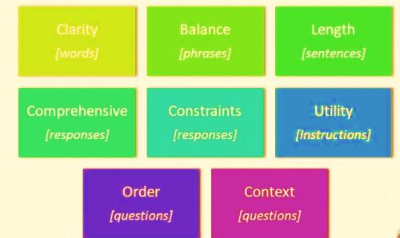
Key Elements Of The Data Collection Tool
We need a valid, sensible response (information) from the study participants that can be used effectively for our health research needs, and to do that, every data collection tool needs some key elements like:
(1) clarity of words that you use in a data collection tool,
(2) the balance of phrases and sentences,
(3) the length of sentences; how long are these questions,
(4) the comprehensiveness of the responses in terms, if you are giving categories of responses that you expect from the study participants.

Slide 20
Key Elements Of The Data Collection Tool
(5) post constraints in terms of what information could or could not be collected through a data collection tool.
(6) utility of the data collection tool and especially the utility of the instructions.
(7)The order in which the questions are asked is a very important element which can decide how your respondents answer your questions, and
(8) the context in which you frame these questions and the tools are used.

Slide 21
Four components of Data collection tools
The introduction is used to present the study to the study participants, state out the objectives and probably get informed consent and so forth.
It is also good to always have a concluding statement at the end of your questionnaire and thank the study participant for their time and effort that they have put in to answer your questions.

Slide 22
Four components of Data collection tools
Identifiers, which could be either the actual identifiers, the information such as the name and address of the study participant, which can identify who the person is, it is always a good idea from an ethical and a human subject protection perspective, if you are collecting this data, to collect this in a separate sheet of paper and which can be referred to later on, if need be.
On the other hand, in order to maintain confidentiality investigators also use coded id numbers to give identifiers to the study participants and these id numbers could be composite in such that they could have numbers which denote say, the state which the person belongs to the district the village and then the household and then the individual id. So, it could be a mix of all these numbers, all these codes, and then you get a composite code looking at which you can actually identify who the respondent is, but would not be able to actually get an exact identification, and which is good from the confidentiality perspective.

Slide 23
Four components of Data collection tools
In terms of the instructions, there could be general instructions for the data collectors, such as prompts in terms of, for example, do not read out all the responses, tick only the one that the study participant mentions.
There could be instructions for skip patterns, now the questionnaires may have skip patterns in the sense that there may be some questions which, based on the response to those, the subsequent question may not be relevant and then there is an instruction, which says that you skip this from question 2, you may go to say question 19 and skip rest of the questions because they are not relevant to this study participant.
It is also always a good idea to may be used different fonts, so as to make it clear that what is the actual question and which part of the item is actually an instructions for the data collector.

Slide 24
Four components of Data collection tools
The whole body of the instrument, which is basically the question items.
Now, these question items could be of various types, we could have what are called open questions, we could have closed-ended questions, and we could have somewhere, something in the middle.

Slide 25
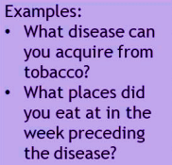
Open questions
Answers are not suggested
Respondents must generate an answer
Advantages
Give freedom of response
Stimulate memory
Can be useful to generate closed responses later
Useful at a hypothesis-raising stage (wherein we are really not sure what the appropriate answer is and you can generate a lot of responses from the study participants).
Inconvenient (as it generates a lot of responses)
Difficult to code and analyze
Responses may be incomplete and/or unfocused

Slide 26
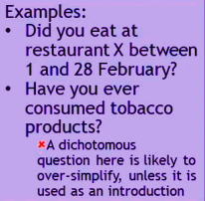
Closed Questions
Closed questions are those where you have a question and you have a set category of answers only, which are the ones that are acceptable to the investigator.
1. Dichotomous options
Suggested answers include 2 options only
Yes and No
Male and female
Advantages
Forces a clear position
May be useful for key, important, well-framed issues
Inconvenient
May oversimplify issues

Slide 27
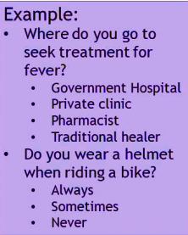
Closed questions
The important thing to note is that, while you are designing the questionnaire, you need to put a clear instruction for the data collector, whether only one answer is acceptable for this question or more than one answer may be acceptable.
2. Multiple options
Multiple options of answers are suggested
One or multiple answers are acceptable
Advantage
Larger choice of answer options
Inconvenient
It may be difficult to choose only one option

Slide 28
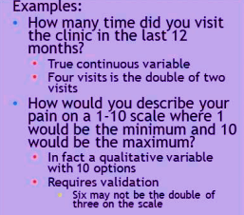
Closed questions
3. Quantitative answers
The respondent must provide a quantified answer (the respondent has to provide a number, such as age).
Advantage
Allows creation of continuous variables
Inconvenient
May require validation: Some "quantified" answers might be limited in the way they can be handled as continuous variables.

Slide 29
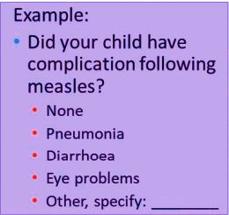
Semi-open questions
Semi-open questions, where you
basically have a question with several responses, the answers here are suggested, but there may be one option where, which is kept open and the most common one that we see in data collection tools and questionnaires is others
Suggested answers
Possibility to create another answer
Other, specify:
Advantage
Leaves the door open to unplanned answers
Inconvenient
Difficult to analyze

Slide 30
Formulating questions
Write short and precise questions
Full and complete phrases
Avoid ambiguities
Use simple words of everyday language
Avoid negatives and double negatives
Do you sometimes care for patients without washing hands?
Do you systematically wash hands before caring for each patient?

Slide 31
Formulating questions
Ask only one question at a time
Did you refuse treatment because you feared side effects?
Did you refuse treatment?
If yes, was this because you feared side effects?
Be specific
* Are you aware of the modes of transmission of HIV?
Among these practices, can you tell me those that could expose you to HIV?
Use a neutral tone to avoid influence
* Have you been promiscuous in the last six months?
How many partners have you had in the last six months?

Slide 32
Sorting the order of questions
From simple to complicated
From general to specific
From casual to intimate
Group together questions related to the same topic
Identification questions at the beginning or at the end
In chronological order, if questions related to the sequence of events
Introduce simple questions as a break if the questionnaire is complex
Triangulate through multiple questions on the same topic if the subject is important

Slide 33
Laying out the data collection tool
Split the sections
Space out questions
Use a vertical format for closed-end responses
Use large fonts
Do not split questions across pages
Align your questions on the left-hand side
Align answers/codes on the right-hand side
Standardize coding
Number all questions
Use auto-coding procedures
Q. Where did you go when your child had diarrhoea
Hospital
Public clinic
Private clinic
Pharmacist

Slide 34
Finalizing the data collection tool
Checking the instrument against the objectives/analysis plan
Suppress unnecessary questions
Add missing questions

Slide 35
Finalizing the data collection tool
Reviewing the instrument
Colleagues
Experts
Statisticians (Coding)
Field workers
Data entry operators

Slide 36
Finalizing the data collection tool
Language of the instrument
Write in the language in which they will be administered
Translation is required
Initial formulation (e.g., in English)
Translation (e.g., in Hindi)
Back-translation (e.g., back to English)

Slide 37
Pilot testing the data collection tool
Check that the instrument is:
Clear
Understandable
Acceptable
Check the flow and skip pattern
Check the pertinence of coding
Estimate the time needed to ask all the questions
Pilot test with a few volunteers
Persons similar to the study population
Persons who are not to be included in the study

Slide 38
Designing health research tools

Slide 39
Principles of data collection

Slide 52
THANK YOU

