Slide 1
REFERENCE WRITING Dr. Mumal mishra Prof. Anatomy

Slide 2
The British Standards Institution defines reference as “a set of data describing a document, sufficiently precise and detailed to identify it and enable it to be located.”

Slide 5
Importance of Proper Referencing
It helps the readers to identify and locate the sources.
It provides an overview of the techniques/tools used.
It is a proof of the author's in-depth reading and knowledge on the subject

Slide 6
Organizing the References
Type the references on a separate MS Word document simultaneously.
Cite with respect to the content of the article.
Re-cite only the most relevant articles

Slide 7
SOURCES
Books
Legal documents
Journal articles
Newspaper articles, Reports (e.g., official reports from government departments)
University working papers
Papers presented at conferences
Internet sources (including weblogs – blogs and email correspondence)
DVD/CD databases, radio/television/videos/audio cassette/CD-ROMs, interview transcripts, and illustrations.

Slide 8
Choosing Appropriate References
Filtering references may seem hard.
Original source is completely read and correctly interpreted before its citing.
Choose a landmark article on the topic.

Slide 9
Use the most recent relevant resources however, certain landmark papers may also be cited (even if they are old).
Use articles of highest level of evidence (such as meta-analysis) or trustworthy sources such as reputed peer-reviewed journals (with higher impact factor), open access and preferably indexed on reputed databases such as MEDLINE and PubMed.

Slide 10
Avoid Padded citation/ Coercive citations.
A judicious combination of original as well as review articles
Avoid citing conference abstracts (lack an appropriate peer review).

Slide 11
Online sources, such as audio and video presentations, should be used with caution.
Avoid personal communications and limit their use to situations where essential information is unavailable from a public source
There is no need to provide references to facts of common knowledge.

Slide 12
Avoid errors while copying the uniform resource locator (URL) or the webpage, or the website may change or be closed/inaccessible. Cite them only if very essential and check for their reliability and give the date of access.
Use online sources with digital object identifiers (DOIs).

Slide 13
Check the US National Library of Medicine's (NLM's) PubMed database (http://www.pubmed.org) for any recently published articles related to the manuscript's topic.
The number of references is determined by the target journal requirements as well as the type of manuscript submitted.

Slide 14
Preparing the References
Citation consists of two components – the “in-text citation” and the “reference list.

Slide 15
The basic elements while referencing
Journal/research paper: Name of author/s, title of paper, journal title, publication year, volume number, issue number, and page numbers or e-article number.

Slide 16
Book/chapter: Chapter author/s, title of chapter, editor/s, name of book, edition, publisher, city of publication, year of publication, and page numbers.

Slide 17
Web sources: Names of author/s, title of webpage, year, weblink, date of access, and other information such as publisher, year of publication. When citing a webpage, provide the DOI or URL of the original source as far as possible.
Use proper punctuations
Adjustments with each revision

Slide 18
Citation styles with examples

Slide 24
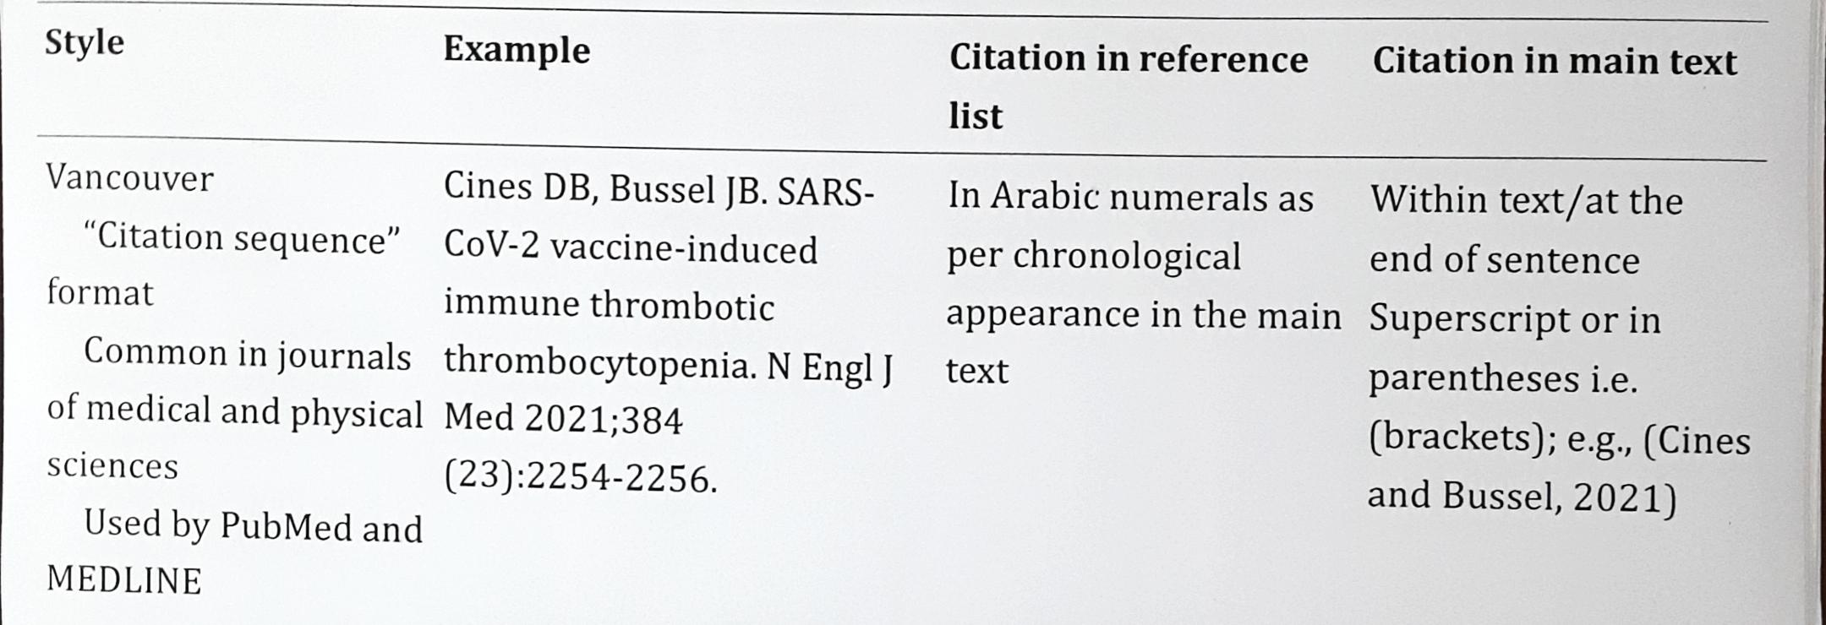

Slide 35
THESIS/PROTOCOL WRITING STRUCTURED FORMAT

Slide 39
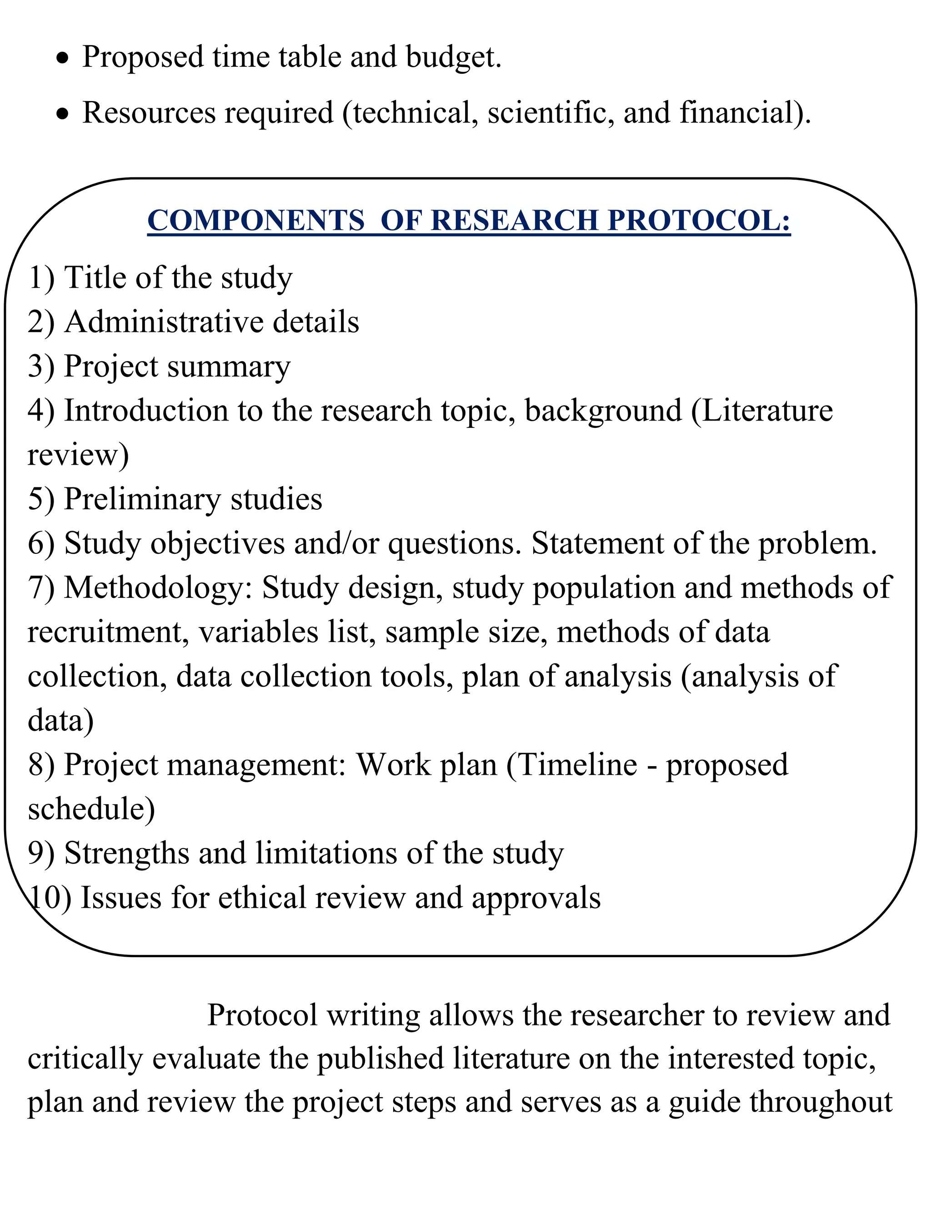

Slide 58
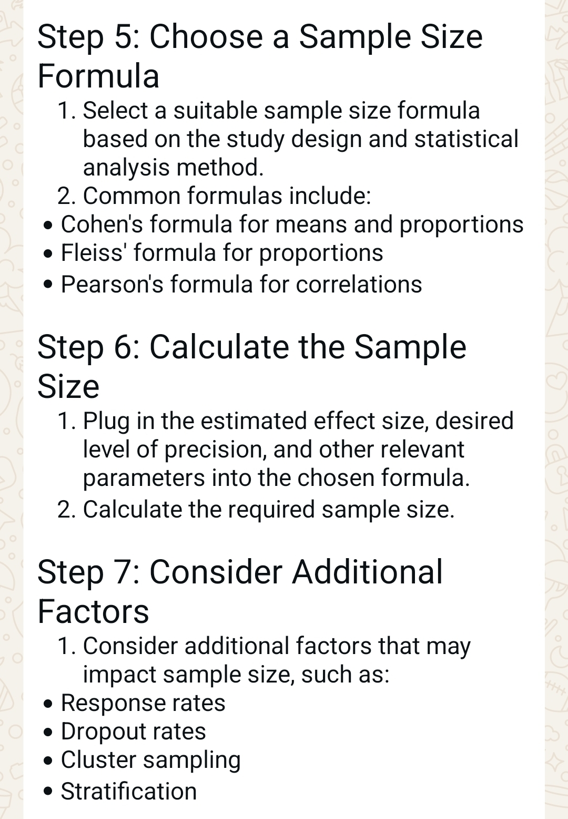

Slide 68
