Slide 1
Literature Search Problem Statement & Rationale
Dr. Divakar Srivastava
Professor, Department of Microbiology

Slide 2
Steps of Literature Review
Notes:
Research stems from an unanswered question

Slide 3
Need for Literature Search
Provides better understanding of the subject matter. Link between known & unknown
Suggests new research topics, questions & methods
Helps in developing a coherent scientific argument for the problem statement/research idea
Notes:
Unawareness of the research topic may lead to unnecessary/ futile effort.

Slide 4
How Literature Search Helps:
Formulating the Research Question
Developing the Problem Statement
Justifying the rationale
Planning the study
Notes:
Formulating the Research Question:
The literature search helps identify the gaps and inconsistencies in existing knowledge, which can inform the formulation of a clear and focused research question.
Developing the Problem Statement:
By understanding the existing literature, researchers can better define the problem and explain its significance
Justifying the Rationale:
The literature search provides the evidence needed to justify the need for the research and its potential impact
Planning the Study:
The literature search helps identify relevant methodologies, data sources, and potential challenges, which can inform the planning of the research study

Slide 5
NMC approved Indexing services
Medline
PubMed Central
Embase
Scopus
Science Citation Index
Science Citation Index Expanded
DOAJ
Central Citation Index
Index Copernicus is NOT an accepted indexing service by the NMC.
"Expanded Embase" does not exist. The correct term is "Embase”

Slide 6
Good Starting Points
Ask your guide for key researchers/papers in the field
Read through some of these papers
Look for relevant sources in the reference list
Look for relevant source that cite the paper (PubMed, Research Gate etc.)

Slide 7
Steps of Literature Review
Retrieval of existing knowledge from valid sources
Organised search
Critical appraisal
Synthesis of results
Identification of Lacunae
Notes:
Review should not be confused with summary, rather it is scanning the literature efficiently using manual or computerised methods to identify a set of potentially useful articles & books.
The ability to apply principles of analysis to identify those studies which are valid & unbiased
Relate the search to the problem statement. Valid & unbiased. Concept of POEM ( PATIENT ORIENTED EVIDENCE THAT MATTERS)
Synthesis of results is a summary of what isn't known. May Guide Us To Either Frame A New Problem Statement/ Or Revise The Existing One
Identification of lacunae followed by the development of a research question

Slide 8
Information Retrieval Mechanism
Web search engines
HON certified websites
PubMed, PubMed Central, MEDLINE
Scopus, Google Scholar
Cochrane Library
ChatGPT
DARE
Notes:
Identifying, within a large database, a subset of documents whose content is relevant to user’s need. Data is mostly stored in electronic databases & we need to search it efficiently
HON – “Health on Net” non-profit making accrediting body – for general research e.g: WebMD, Drugs.com, Healthline
For specific scientific query – PubMed, Scopus, etc
For evidence-based research article – Cochrane Library ( collection of EBM, Systematic reviews & meta-analyses)
DARE- DATABASE OF ABSTRACTS OF REVIEW OF EFFECTS

Slide 9
Comparison
 | PubMed | Google Scholar | Cochrane Library | Dare | ChatGPT
Reliability | Reliable | Less Reliable | Reliable | Reliable | Not Credible
Limitation | Overwhelming, require advance search options | Less precise as algorithm is not transparent | Paid | Abstracts only | Use with caution

Slide 10
PubMed
Produced by National Library of Medicine (NLM)
One of the largest biomedical literature database
Provides free access to MEDLINE
Covers medicine, public health, nursing, dentistry & much more
Notes:
Medline in NLM database of citations and abstracts around the world.

Slide 11
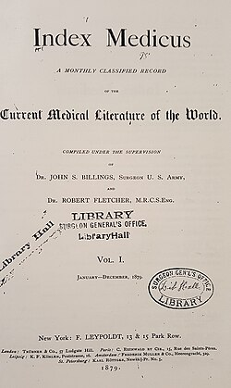
National Library of Medicine
Notes:
The NLM started indexing biomedical literature in 1879, initially as a printed index called Index Medicus.
In 1960, it became one of the earliest online sources for information, though it required a fee.
Free public access to MEDLINE through PubMed became available in 1996.

Slide 12
Difference between MEDLINE and PubMed
MEDLINE is NLM’s database of journal citations and abstracts for biomedical literature
MEDLINE citations have been indexed and reviewed for accuracy
Medical Subjects Headings (MeSH) are specialized subject headings (a controlled vocabulary) used to index citations in MEDLINE
PubMed is the tool that allows MEDLINE to be searchable
Notes:
MEDLINE is the database of journal citations and abstracts, with citations reviewed for accuracy and indexed using Medical Subject Headings (MeSH)

Slide 13
Ways to Search MEDLINE
FREE
$$$$

Slide 14
PubMed Layout

Slide 17
Basics of Searching

Slide 18
Outline
Boolean operators: AND & OR
Nesting to group similar items
Truncation of words with multiple endings
Quotes for phrase

Slide 19
Steps to Take
Add in Similar terms placing an OR in between them
Group OR terms in parentheses
Put in double quotes around the multi-word phrases
Truncation

Slide 20
Filters & Field tags

Slide 21
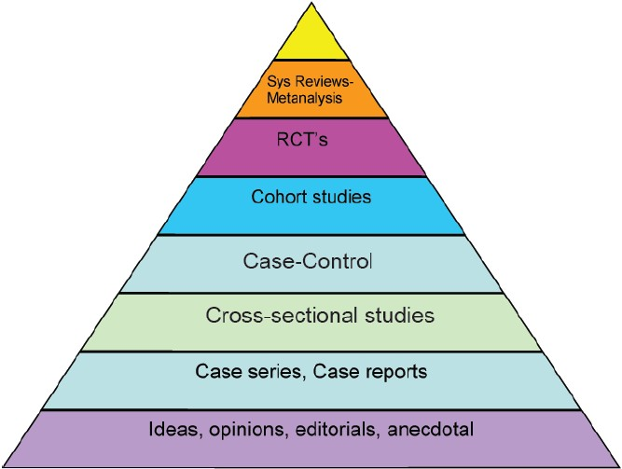
Critical Appraisal

Slide 22
Field tags
Used to quickly access a few articles AND
Standardly used for systematic reviews
Special tag at the end of search term
Use brackets

