Slide 5
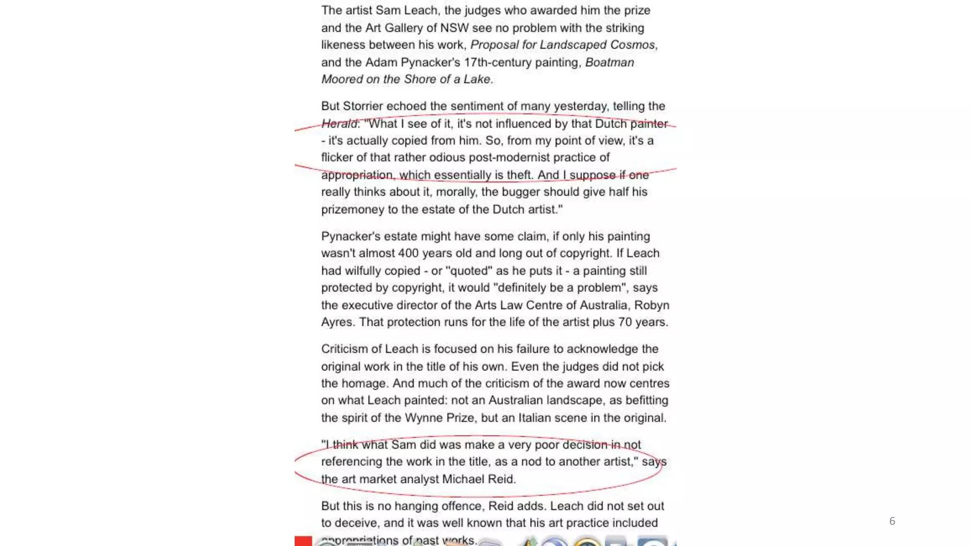

Slide 7
Key Components of the Hegelian Dialectic:
Thesis: The initial understanding or proposition.
Antithesis: A counter-proposition that challenges or negates the thesis.
Synthesis: A new understanding that reconciles or surpasses the contradictions of the thesis and antithesis, creating a higher level of understanding.

Slide 8
How the Dialectic Works:
Thesis: An initial idea or concept is presented.
Antithesis: A contrary idea emerges, questioning or contradicting the initial thesis.
Sublation: The process of "Aufhebung" (sublation) occurs. This involves preserving the truth of the thesis while also negating it, and then elevating the understanding to a higher level.
Synthesis: A new understanding emerges that incorporates the insights of both the thesis and antithesis, resolving the conflict and leading to a more comprehensive concept.

Slide 13
