Slide 1
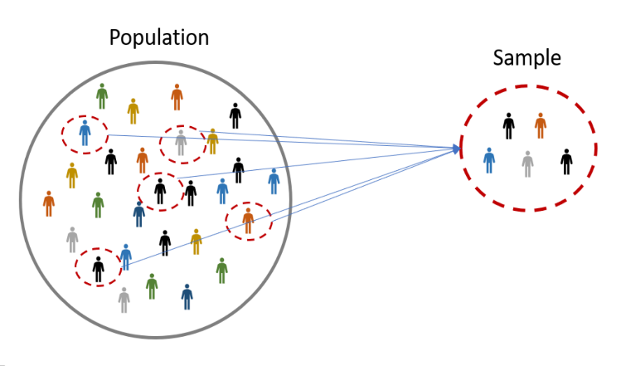
Sampling and Sample Size
Dr. Shivendra Pratap Singh
(Statistician cum Assistant Professor)
Department of Community Medicine
Hind Institute of Medical Sciences, Mau, Ataria, Sitapur

Slide 2
Topics to be covered
What is Sampling?
Basic terminologies
Characteristics of a Good Sample
Advantages of sampling
Disadvantages of sampling
Classification of Sampling Techniques
Basic of Study Design
Sample Size Determination

Slide 3
What is Sampling?
Sampling is the process of learning about the population on the basis of a part of the population (called sample) drawn from the population.

Slide 4
Basic Terminologies
Population: It refers to the group of people, items or units under investigation and includes every individual.
Sampling Unit: Sampling units are the individual entities that are selected from a larger population to be included in a sample.
Sample: A collection consisting of a part or subset of the objects or individuals of population which is selected for the purpose, representing the population.

Slide 6
Characteristics of a Good Sample
A true representative of the population.
Free from error due to bias.
Adequate in size for being reliable.
Units of sample should be complete precise and up to date.
Free from random sampling error.

Slide 7
Advantages of Sampling
Economical: Reduce the cost compare to entire population.
Increased speed: Collection of data, analysis and Interpretation of data etc. take less time than the population.
Accuracy: Due to limited area of coverage, completeness and accuracy is possible.

Slide 8
Disadvantages of Sampling
Biasedness: Chances of biased selection leading to incorrect conclusion.
Selection of true representative sample: Sometimes it is difficult to select the right representative sample.
Need for specialized knowledge: The researcher needs knowledge, training and experience in sampling technique, statistical analysis and calculation of probable error.
Impossibility of sampling: Sometimes population is too small or too heterogeneous to select a representative sample.

Slide 9
Homogeneous Data:
If the values of the variable in the population are not affecting by any external factor.
Heterogeneous Data:
If the values of the variable in the population are affecting by any external factor.
Example
Data on birth weights of babies born to women from a poor socioeconomic class alone are homogeneous.
Data on birth weights of babies born to women from high, middle and poor socioeconomic classes are heterogeneous.

Slide 10
Classification of Sampling Techniques
Sampling
Non-Probability Sampling
Probability Sampling
Volunteer Sampling
Simple Random Sampling
Quota Sampling
Stratified Random Sampling
Convenience Sampling
Systematic Random Sampling
Purposive Sampling
Cluster Sampling
Snowball Sampling
PPS Sampling
Multistage Sampling

Slide 11
Probability Sampling (Random Sampling)
Sampling in which each sampling unit has a known and nonzero probability of being included in the sample.

Slide 12
Simple Random Sampling
Ideal for small and homogeneous population
Every unit of the population has equal chance of being selected
SRS Methods
Lottery method
Random number table

Slide 13
Example
Estimate hemoglobin levels in patients with anemia
Determine sample size.
Obtain a list of all patients with anemia in a hospital or clinic.
Patient is the sampling unit.
select units randomly.
Measure hemoglobin in all selected patients.
Estimate the levels (normal & abnormal) of hemoglobin.

Slide 14
Stratified Random Sampling
Ideal for non-homogeneous.
Non-homogeneous population in converted to homogeneous groups/strata.
Population is divided into strata according to characteristics such as age, socioeconomic status, religion etc.

Slide 15
Example
Assess dietary intake in adolescents
Define three age groups: 11-13, 14-16, 17-19.
Stratify age groups by sex.
Obtain list of children in this age range from schools.
Randomly select children from each of the 6 strata until sample size is obtained.
Measure dietary intake.

Slide 16
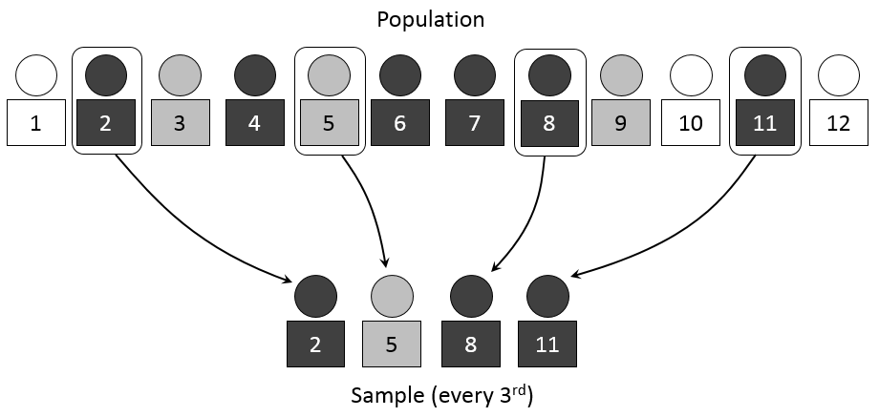
Systematic Random Sampling
Used for large and non-homogeneous population
Based on sampling fraction- every $K^{th}$ unit is chosen from a population list
$K\text{(}\text{sampling} \text{interval}\text{) =}\frac{\text{Total} \text{number} \text{of} \text{units} \text{in} \text{population}}{\text{Total} \text{number} \text{of} \text{units} \text{in} \text{sample}}$

Slide 17
Example
If a systematic sample of 500 students were to be carried out in a university with an enrolled population of 10,000, the sampling interval would be:
I = N/n = 10,000/500 =20
All students would be assigned sequential numbers. The starting point would be chosen by selecting a random number between 1 and 20. If this number was 9, then the 9th student on the list of students would be selected along with every following 20th student. The sample of students would be those corresponding to student numbers 9, 29, 49, 69, ........, 9929, 9949, 9969 and 9989.

Slide 18
Cluster Sampling
Example
To estimate vaccination rates, researchers might divide a city into clusters (neighborhoods) and select random neighborhoods to survey every household within them.

Slide 19
Probability Proportional to Size (PPS) Sampling
PPS sampling is a valuable technique in medical research when dealing with varying sizes of study units and when the variable of interest is related to size.
Example
A study on the prevalence of a certain disease across different hospitals in a region. Instead of selecting hospitals randomly, a PPS approach could be used. Hospitals with more beds, more patient visits, or a larger number of specific departments (e.g., ICU, ER) would be given a higher probability of being selected for the study. This ensures that the sample is more representative of the overall population of hospitals and that the results are more reliable.

Slide 20
Multistage Sampling

Slide 21
Example
Selection of 1200 higher secondary students from schools of Delhi
Two-stage Sampling
Three-stage Sampling
Selection of 20 out of 100 higher secondary schools using simple random sampling/PPS sampling
Selection of 20 out of 100 higher secondary schools using simple random sampling/PPS sampling
Selection of 2 out of the total sections in each of the selected higher secondary schools using SRS
Selection of 60 out of the total number of higher secondary students in each of the selected school
Selection of 30 students from each section of the selected higher secondary school

Slide 22
Non-Probability Sampling (Non-random Sampling)
Non-probability sampling relies on non-random selection methods, often based on convenience or judgment, where not all population members have an equal or known chance of being included.

Slide 23
Volunteer Sampling
Volunteer sampling in medical research involves recruiting participants who willingly offer to participate in a study, often through advertisements or by reaching out to specific support groups or online communities. This method is frequently used when studying rare conditions or when ethical considerations prevent random selection.
Example
Individuals with specific medical conditions might volunteer to participate in clinical trials to potentially benefit from new treatments, even if there's a chance of side effects.

Slide 24
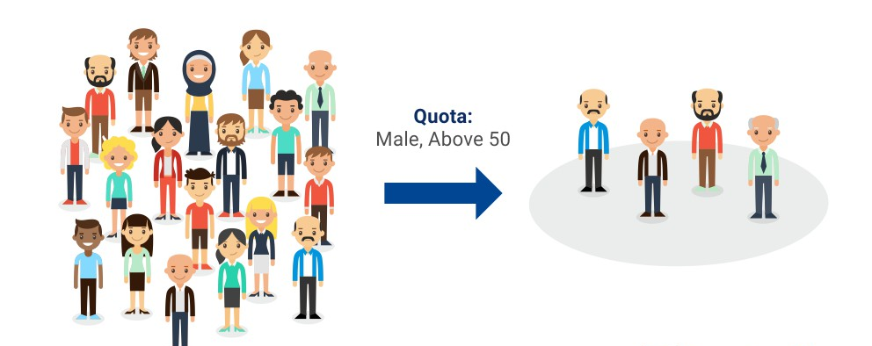
Quota Sampling
Example
A medical institute will conduct a study on arthritis patients and will set a quota of 60 women and 40 men (above 50 years of age) to be examined per day. Hence, the first 60 women and 40 men (above 50 years of age) visiting the institute will be included in the study.

Slide 25
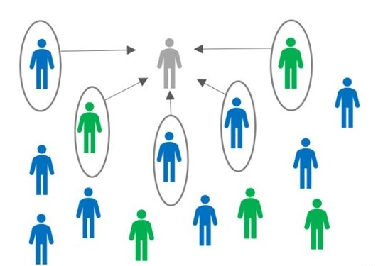
Convenience Sampling
Subjects are selected on the basis of their availability and convenience of the researcher.
Example
A study on pain management in a hospital might use convenience sampling by including patients who are currently in the hospital and meet the study criteria.

Slide 26
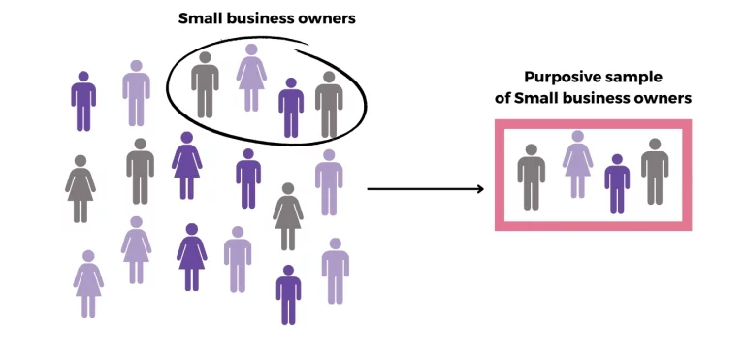
Purposive Sampling
Example
A study on the experiences of nurses during the COVID-19 pandemic might use purposive sampling to select nurses from different regions and healthcare settings.

Slide 27
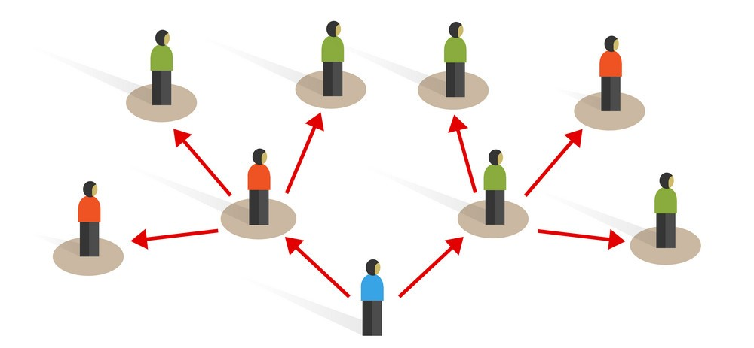
Snowball Sampling
Example
In studies on HIV/AIDS, snowball sampling has been used to estimate prevalence among injection drug users and understand risk behaviors within this population.

Slide 28
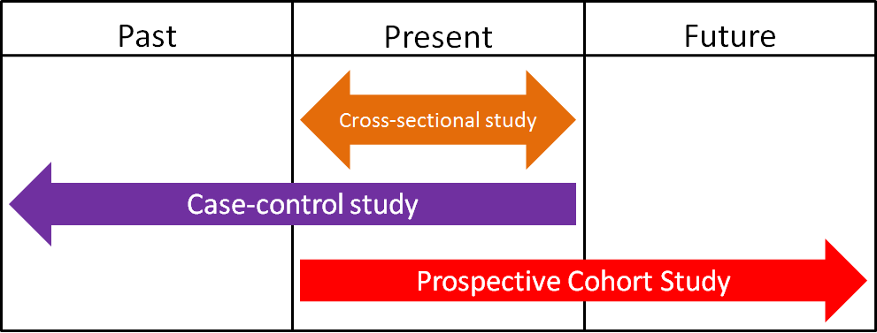
Study Design
The most common study design used in research studies:
Cross sectional study
Case control study
Cohort study

Slide 29
Hypothesis
Effectiveness of two drugs (A and B)
Null Hypothesis ($H_{0}$): $A=B$
Alternative Hypothesis ($H_{1}$):
$A ≠ B$(Two sided)
$A < B$(one sided)
$A >B$(one sided)

Slide 30
Z values
 |  | Z-value
 |  | Two sided test |  | One sided test
 |  | $$Z_{1−α/2}$$ |  | $$Z_{1−α}$$
Significance level | 0.01 | 2.576 |  | 2.326
 | 0.05 | 1.96 |  | 1.645
 | 0.10 | 1.645 |  | 1.282
 |  |  | $$Z_{1−β}$$
Power | 0.80 |  | 0.842
 | 0.90 |  | 1.282
 | 0.95 |  | 1.645
 | 0.99 |  | 2.326

Slide 31
Absolute Error: The absolute error is the magnitude of the difference between the measured value and the true value.
Example: If a blood pressure measurement is 120 mmHg and the true value is 118 mmHg, the absolute error is 2 mmHg.
Absolute error$=$Relative Error$×$ $True value$
Relative Error: The relative error is the absolute error divided by the true value.
Example: Using the blood pressure example above, if the true value is 118 mmHg, the relative error is (2/118) which is approximately 0.017 or 1.7%.

Slide 32
Sample Size Determination
In designing an experiment, a key question is:
How many person/subjects do I need for my experiment?
Too small of a sample size can under-detect the effect of interest in your experiment.
Too large of a sample size may lead to unnecessary wasting of resources.
Sample size calculation is to determine the number of samples needed to detect significant changes in clinical parameters, treatment effects or associations after data gathering.

Slide 33
Estimation of Mean (For Quantitative variables)
To calculate sample size requirement for estimating mean of a quantitative variable in a study population:
$$n=\frac{{\left(Z_{1−α/2}\right)}^{2} s^{2}}{d^{2}}$$
$Z_{1−α/2}=$ Value of the normal deviate at considered level of confidence
$s=$ Standard deviation of the variable in group
$d$= Expected absolute allowable error in mean

Slide 34
Q1. To estimate hemoglobin level (g/dl) among pregnant women of a community, it was expected that the mean and standard deviation of hemoglobin in pregnant women from the considered community were about 10.3 and 2.3 (g/dl), respectively. Then, at α=0.05 and relative allowable error 10%, how many pregnant women from the community should be studied
Cal. We have: Mean, $\overline{x}=10.3,$ Standard deviation, $s=2.3$ , $d= \frac{10}{100}∗10.3=1.03$,
Therefore, the required sample size:
$$n={\left(\frac{Z_{1−\text{α}\text{/2}}∗s}{d}\right)}^{2}$$
$$n={\left(\frac{1.96∗2.3}{1.03}\right)}^{2}$$
$$n=19$$

Slide 35
Comparison of two means (For Quantitative variables)
To calculate sample size requirement for comparing means of a quantitative variable between treatment and control group:
$$n=(s_{1}^{2}+s_{2}^{2})\frac{{\left[Z_{1−α/2}+Z_{1−β}\right]}^{2}}{{({\overline{x}}_{1}−{\overline{x}}_{2})}^{2}}$$
$Z_{1−α/2}=$ Value of the normal deviate at considered level of confidence
$Z_{1−β}=$ Value of the normal deviate at considered power of the study
$s_{1}=$ Standard deviation of the variable in group 1
$s_{2}=$ Standard deviation of the variable in group 2
${\overline{x}}_{1}=$ Mean of the variable in group 1
${\overline{x}}_{2}=$ Mean of the variable in group 2

Slide 36
Q2. A study to see the effect of iron supplements for a specific period on hemoglobin level among pregnant women of a community has to be carried out. Under a preliminary study or as reported in the literature, it was observed that the standard deviation of hemoglobin in pregnant women from a similar community with an intervention was 2.3 (g/dl), while that without intervention was 3.4 (g/dl). If a = 0.05 and β = 0.20, how many pregnant women from each group should be studied if one wants to detect a difference of 2.0 (g/dl) in hemoglobin in the two groups?
Cal. We have: Mean difference, ${(\overline{x}}_{1}−{\overline{x}}_{2})=2.0,$ Standard deviations, $s_{1}=2.3$ , $s_{2}=3.4$
(a). For a two-sided test:
$$n=\left(s_{1}^{2}+s_{2}^{2}\right)\frac{{\left[Z_{1−α/2}+Z_{1−β}\right]}^{2}}{{\left({\overline{x}}_{1}−{\overline{x}}_{2}\right)}^{2}}$$
$$n=({2.3}^{2}+{3.4}^{2})\left(\frac{{\{1.96+0.842\}}^{2}}{{2.0}^{2}}\right)$$
$$n=33$$
(b). For a one-sided test:
$$n=\left(s_{1}^{2}+s_{2}^{2}\right)\frac{{\left[Z_{1−α}+Z_{1−β}\right]}^{2}}{{\left({\overline{x}}_{1}−{\overline{x}}_{2}\right)}^{2}}$$
$$n=({2.3}^{2}+{3.4}^{2})\left(\frac{{\{1.64+0.842\}}^{2}}{{2.0}^{2}}\right)$$
$$n=26$$

Slide 37
Estimation of Proportion (Prevalence Study) (For Qualitative variables)
Cross Sectional Study
To calculate sample size requirement for estimating prevalence of an event in a population:
$$n=\frac{Z_{1−α/2}^{2} p(1−p) }{d^{2}}$$
$Z_{1−α/2}=$ Value of the normal deviate at considered level of confidence
$p=$ Expected prevalence of the event in the study group
$d=$ Expected absolute allowable error in prevalence

Slide 38
For rare events/diseases:
When $p <10\%$
$d=p/2$
For common events/diseases:
When $p>90\%$
$d=(1−p)/2$

Slide 39
Q3. The current prevalence of malaria in a community is expected to be around 40%. Hence, to estimate the current prevalence of malaria in that community, how many persons should be included in the study at 5% level of significance and absolute allowable error as 10%?
Cal. We have: prevalence, p$=0.40,$ absolute allowable error, d $=0.10$
$$n=\frac{{\left(Z_{1−α/2}\right)}^{2} p(1−p)}{d^{2}}$$
$$n=\left(\frac{\left({1.96}^{2}\right)∗0.40(1−0.40)}{{0.10}^{2}}\right)$$
$$n=92$$

Slide 40
Comparison of two Proportions (For Qualitative variables)
Cross Sectional Study
To calculate sample size requirement for comparing proportions of an event between two groups (e.g. treatment and control groups):
$$n=\frac{{\left[Z_{1−α/2}\sqrt{2p(1−p)}+ Z_{1−β}\sqrt{p_{1}\left(1−p_{1}\right)+p_{2}(1−p_{2})}\right]}^{2}}{{(p_{1}−p_{2})}^{2}}$$
$Z_{1−α/2}=$ Value of the normal deviate at considered level of confidence
$Z_{1−β}=$ Value of the normal deviate at considered power of the study
$p=$ Expected proportion of the event in the study group
$p_{1}=$Expected proportion of the event in the study group 1
$p_{2}=$Expected proportion of the event in the study group 2

Slide 41
Q4. Children attending public schools have expected dental problem among them as 80%. In another group of children attending government/municipal corporation schools, 70% are expected to have this problem. How many children should be included from each group to determine whether this difference is significant at 5% level if we wish to have 80% chance of detecting the difference if it is real?
Cal. We have, $p_{1}=0.8,p_{2}=0.7 ⇒p= \frac{p_{1}+p_{2}}{2}= \frac{0.8+0.7}{2}=0.75$
(a). For a two-sided test:
$$n=\frac{{\left[\begin{aligned}Z_{1−α/2}\sqrt{2p(1−p)} \\ + Z_{1−β}\sqrt{p_{1}\left(1−p_{1}\right)+p_{2}(1−p_{2})}\end{aligned}\right]}^{2}}{{(p_{1}−p_{2})}^{2}}$$
$$n= \frac{{\left[\begin{aligned}1.96\sqrt{2∗0.75∗(1−0.75)}+ \\ 0.842\sqrt{0.80∗\left(1−0.80\right)+0.70(1−0.70)}\end{aligned}\right]}^{2}}{{\left(0.80−0.70\right)}^{2}}$$
$$n=294$$
(b). For a one-sided test:
$$n=\frac{{\left[\begin{aligned}Z_{1−α}\sqrt{2p(1−p)} \\ + Z_{1−β}\sqrt{p_{1}\left(1−p_{1}\right)+p_{2}(1−p_{2})}\end{aligned}\right]}^{2}}{{(p_{1}−p_{2})}^{2}}$$
$$n= \frac{{\left[\begin{aligned}1.64\sqrt{2∗0.75∗(1−0.75)}+ \\ 0.842\sqrt{0.80∗\left(1−0.80\right)+0.70(1−0.70)}\end{aligned}\right]}^{2}}{{\left(0.80−0.70\right)}^{2}}$$
$$n=233$$

Slide 42
Estimating an Odds Ratio (with specified relative precision)
Case Control Study
An objective to estimate an odds ratio, any two of the following should we known:
$p_{1}=$Anticipated probability of “exposure” for cases
$p_{2}=$Anticipated probability of “exposure” for controls
$OR=\frac{{p_{1}}/{(1−p_{1})}}{{p_{2}}/{(1−p_{2})}}=$ Anticipated odds ratio
$$n=\frac{Z_{1−α/2}^{2}\left[\frac{1}{p_{1}{(1−p}_{1})}+\frac{1}{p_{2}{(1−p}_{2})}\right]}{{\left[\log{(1−d)}\right]}^{2}}$$
$Z_{1−α/2}=$ Value of the normal deviate at considered level of confidence
$d=$ relative allowable error

Slide 43
For Qualitative Variable (Case Control Study)
Case Control Study
$$n=\frac{r+1}{r}\frac{p(1−p){\left[Z_{1−α/2}+Z_{1−β}\right]}^{2}}{{(p_{1}−p_{2})}^{2}}$$
$r$= Ratio of control to cases
$p$= Average proportion exposed
$p_{1}=$proportion in cases
$p_{2}=$proportion in controls

Slide 44
For Quantitative Variable (Case Control Study)
Case Control Study
$$n=\frac{r+1}{r}\frac{s^{2}{\left[Z_{1−α/2}+Z_{1−β}\right]}^{2}}{{(d)}^{2}}$$
$r$= Ratio of control to cases
$s$= Standard deviation
$d=$Expected mean difference between case and control

Slide 45
Estimating an Relative Risk (with specified relative precision)
Cohort Study
An objective to estimate a relative risk, any two of the following should we known:
$p_{1}=$Anticipated probability of disease in people exposed to the factor of interest
$p_{2}=$Anticipated probability of disease in people not exposed to the factor of interest
$RR=\frac{p_{1}}{p_{2}}=$ Anticipated relative risk
$$n=\frac{Z_{1−α/2}^{2}\left[\frac{{(1−p}_{1})}{p_{1}}+\frac{{(1−p}_{2})}{p_{2}}\right]}{{\left[\log{(1−d)}\right]}^{2}}$$
$Z_{1−α/2}=$ Value of the normal deviate at considered level of confidence
$d=$ relative allowable error

Slide 46
Experimental Studies
Sample size calculation for comparison between two groups when endpoint is qualitative
$$Sample Size =\frac{2{\left(Z_{1−β}+Z_{1−α/2}\right)}^{2}P(1−P)}{{{(p}_{1}−p_{2})}^{2}}$$
$p_{1}−p_{2}$= Difference in proportion of events in two groups
P = [prevalence in case group ($p_{1}$)
+ prevalence in control group ($p_{2}$)]/2
When the endpoint of a clinical intervention study is qualitative like alive/dead, diseased/non diseased, male/female etc., then the following formula can be used for sample size calculation for comparison between two groups. Suppose the researcher is interested in knowing protective effect of a drug on mortality in patients of myocardial infarction. He selected two groups of patients of myocardial infarction one group was given that drug and another group was given placebo. The both groups were kept under observation and at the end of study both groups were compared.

Slide 47
Experimental Studies
Sample size calculation for comparison between two groups when endpoint is quantitative data
$$Sample Size =\frac{2{SD^{2}\left(Z_{1−β}+Z_{1−α/2}\right)}^{2}}{d^{2}}$$
When the variable is quantitative data like blood pressure, weight, height, etc.

