Slide 1
Stats
from Scratch
With
Sandeep Bhattacharya

Slide 2
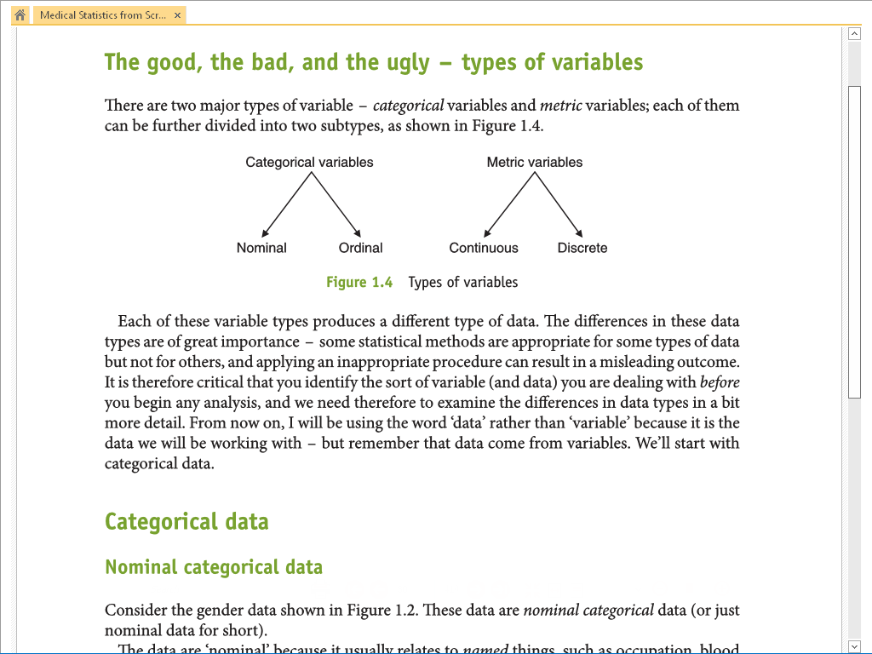
No Unit of Measurement
Qualitative Variable
Has Unit of Measurement
Quantitative Variable
Named things
Eg Male; Female
Has No order
Value is assigned
Eg: Apgar Score
Has a order
By Measurement
Are Real Number
By Counting
Unit: Number of things
Is real number (integer)
Chi Square Test
Student t-Test / ANOVA
Note: This value is actually not Measured but assessed by the researcher hence not a real number

Slide 3

What to do with data !!!
Birth weight of Babies in grams

Slide 4
Measure of Location
ie
Measure of central tendency

Slide 5
Measure of Location
Mode
Measure of common-ness
ie Data with highest frequency
Shortcoming
Not good for large group of data
There may be more than one mode

Slide 6
Measure of Location
Median
Measure of Central-ness
Middle Data
Done by arranging in ascending order

Slide 7
Measure of Location
Mean
Average
Uses all data
Shortcoming
Not possible for categorical data
Affected by outlier so at times may not be true representation

Slide 9
Measure of Spread
ie
Measure of Dispersion

Slide 10
Measure of Spread
Range
  Eg: Birth weight 2170 to 4140 g
  Better than writing 1930g
  Affected by outlier
Inter Quartile Range
  Takes care of outlier in the range
  By removing the first and last quarter values
  In other words gives the middle 50% range of data
Standard Deviation

Slide 11
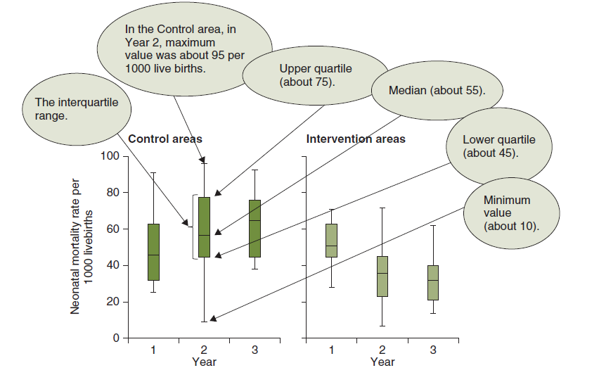
Box Plot and Whisker Plot
Actually shows the IQR

Slide 12
Standard Deviation
Average dist of data from Mean
It’s the average distance of data from Mean
So if data is widely spread SD would be more and vice-versa
Disadvantage of IQR is it omits outer data
SD uses it

Slide 13
Lets calculate SD of Diastolic BP (n=5)
Mean
84
-24
16
100
60
-4
80
70
-14
26
110
But we cannot add them straight away – it will always be Zero
So What to do?

Slide 14

So we fiddle the value by Squaring each value to get rid of negative value
And then take a Square Root
For Some Technical Reasons (which is called "Bessel's correction")
We divide the sum of squares not by n=5 but by n-1 ie 4
So

Slide 15
Do Not Mix-and-Match measures
SD goes with Mean
IQR goes with Median

Slide 16
For Normal distributed data if we know Mean & SD
Then we can say that
“I know 95% of values lie between this much and this much”
Notes:
One way of transforming a not so normal distribution to a normal-ish distribution is to take log (base10)

Slide 17
Confidence interval

Slide 18
Confidence Interval
Sample Mean gives the point estimate for your sample values
      SD gives you the idea of spread of data from sample mean
But how confident are you that your sample mean is same as population mean

Slide 19
If we can take several sample means of whole population
Then we can get bell shape curve of this normal distribution
Mean of this curve would be the Population Mean
And Standard deviation is now the Standard Error

Slide 20
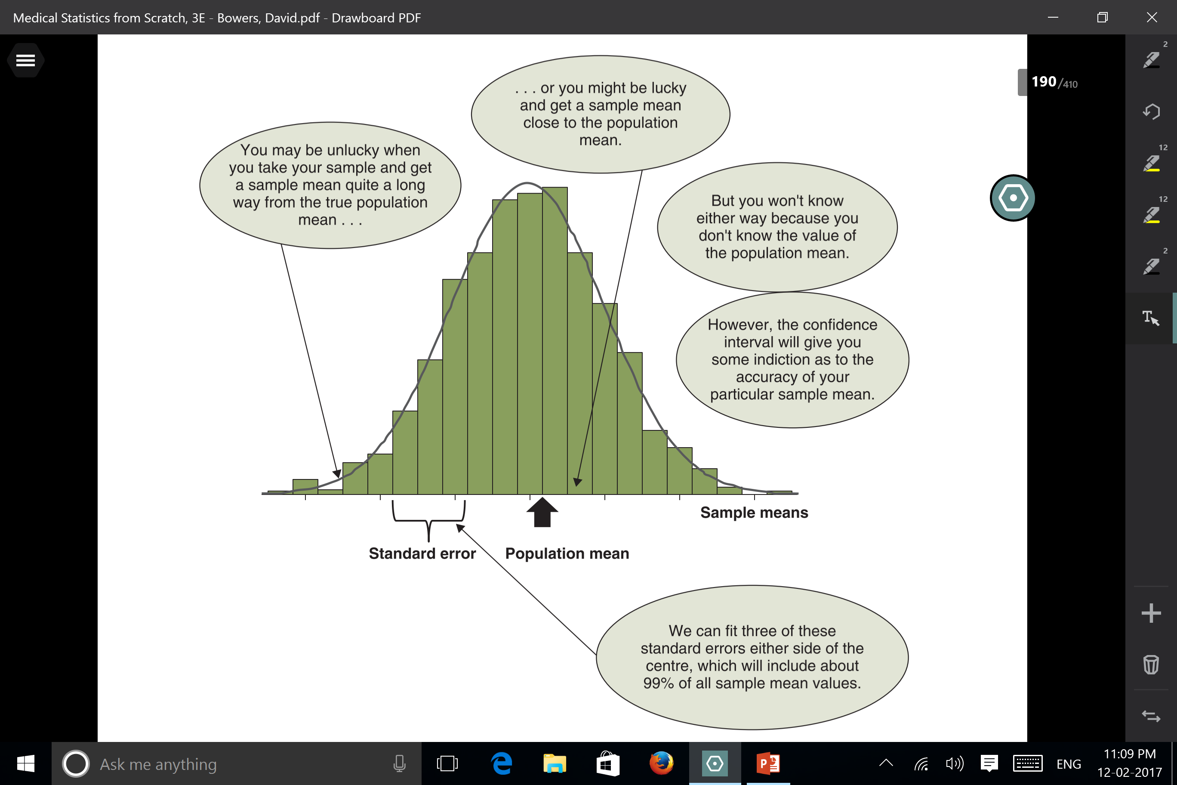

Slide 21
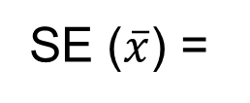


Standard Error
actually Standard Error of Mean
Standard deviation is measure of Spread of data in a Single Sample
SE is measure of Spread of all possible sample means from Population means
SD
√n
Where
SD = Standard Dev of Sample
N = Sample size
As sample size n increases SE decreases
Notes:
We can judge (quantify) the accuracy of our sample mean as an estimate of the population mean with the help of the value of the standard error of the mean, usually abbreviated to standard error, and we do this by using the standard error to calculate a confidence interval

Slide 22
SE is measure of preciseness of sample mean as an estimator of the population mean
Smaller is better
Sample mean with the smallest standard error is likely to be more precise

Slide 23
Confidence Interval = + 2 x SE
In normal distribution + 2 SD and similarly + 2 x SE
includes 95% data hence 95% Confidence Interval
95 per cent confidence interval for the population mean=
[x − 2 × s.e.(x)] to [x + 2 × s.e.(x)]
Eg:
Mean = 100 and SE = 10
Then CI would be 80 to 120
But this method is good for Continuous (metric) value

Slide 24
Hypothesis Testing, Tests of Significance
Type I & II Errors

Slide 25
A Clinical Research Scenario
Study Objective: Evaluate if Drug X reduces systolic blood pressure (SBP) compared to placebo in hypertensive patients.
Design: Randomized controlled trial with two groups
- Drug X group: 25 patients
- Placebo group: 25 patients
Mean SBP reduction (mmHg):
- Drug X: 12 mmHg
- Placebo: 6 mmHg
Standard deviation (assumed): 5 mmHg

Slide 26
What is a Hypothesis?
A hypothesis is a proposed explanation for a phenomenon.
Two types:
- Null hypothesis (H0): No difference or effect
(Drug X = Placebo)
- Alternate hypothesis (H1): There is a difference or effect (Drug X ≠ Placebo)

Slide 27
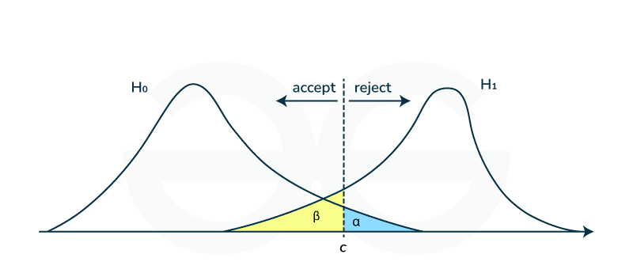

Slide 28
Steps in Hypothesis Testing
1. Define null and alternate hypotheses
2. Choose level of significance (α)
3. Choose appropriate test
4. Calculate test statistic (e.g., t)
5. Determine p-value
6. Compare p-value to α
7. Make a decision: reject or do not reject H0

Slide 29
Level of Significance and p-value
Level of significance (α): Threshold for rejecting H0 (α = 0.05)
p-value: Probability of obtaining observed results assuming H0 is true
Interpretation:
- If p < α: Reject H0 (statistically significant)
- If p ≥ α: Do not reject H0

Slide 30
Type I and Type II Errors
Type I Error: False Positive
(e.g., conclude Drug X is effective when it is not)
Type II Error: False Negative
(e.g., fail to detect effectiveness of Drug X when it actually works)

Slide 31
Power of a Study
Power = 1 - β
(probability of correctly rejecting H0 when H1 is true)
Depends on:
- Sample size
- Effect size
- Variability
- Significance level (α)
Aim for power ≥ 80% in clinical research.

Slide 32


Effect Size
Effect size quantifies the magnitude of difference between groups
Cohen’s d is often used for continuous variables:
Interpretation:
    - 0.2 = small
    - 0.5 = medium
    - 0.8 = large

Slide 33
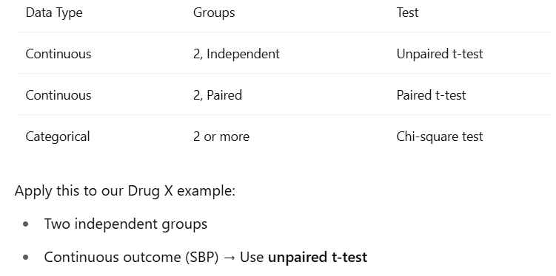

Slide 34

Formula - Unpaired t-test
Where:
- X̄1, X̄2: group means
- s1, s2: standard deviations
- n1, n2: sample sizes

Slide 35
Same study, but now using paired design:
25 patients measured before and after Drug X
Outcome: within-subject change in SBP
Reason to use paired t-test: Controls for inter-patient variability
NOTE: NO separate control arm required

Slide 36

Formula - Paired t-test
Where:
d: Mean of the differences (Post - Pre)
sd: SD of the differences
n: number of subjects
This tests whether the mean difference in SBP is significantly different from 0

Slide 37
Calculating p-value from t-score using t-table
Given from previous calculation:
  t-statistic = 4.24
  Degrees of Freedom (df) = 25 + 25 − 2 = 48
  Test type: Two-tailed
  α = 0.05
Step-by-step:
  Locate t = 4.24 in t-table for df ≈ 50
  t = 2.678 → p = 0.01
  t = 3.496 → p = 0.001
  Our t = 4.24 → p < 0.001
Conclusion: p < 0.001 → statistically significant → reject H0
Don’t worry you do this on computer

Slide 38
t-table Extract (Two-Tailed)
df | p = 0.10 | p = 0.05 | p = 0.01 | p = 0.001
40 | 1.684 | 2.021 | 2.704 | 3.551
50 | 1.676 | 2.009 | 2.678 | 3.496
60 | 1.671 | 2.000 | 2.660 | 3.460
∞ | 1.645 | 1.960 | 2.576 | 3.291
Our t = 4.24 → falls beyond 3.496 → p < 0.001

Slide 39
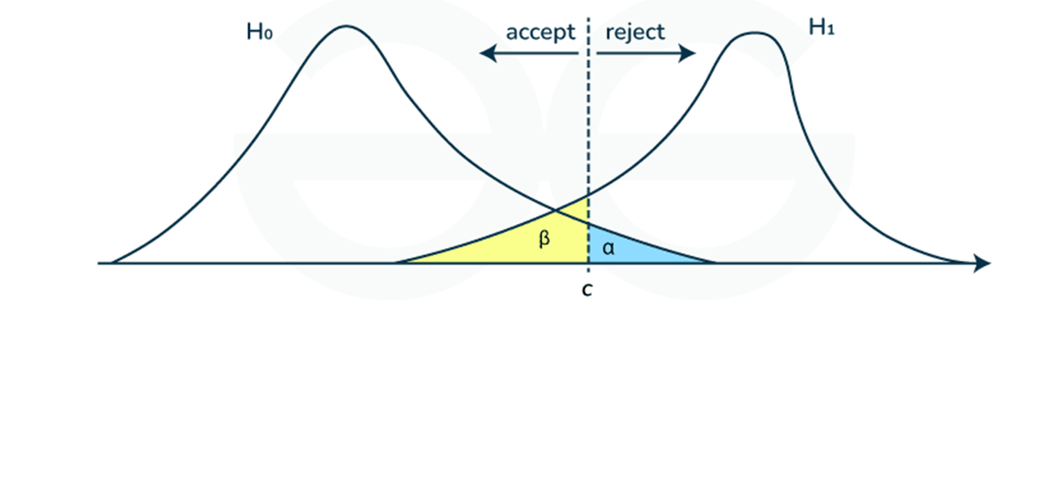
One-tailed vs Two-tailed Test
Two-tailed: Tests for any difference (Drug X ≠ Placebo)
One-tailed: Tests in a specific direction (Drug X > Placebo)
Clinical trials generally use two-tailed to avoid bias.

Slide 40
Common Misinterpretations
- A non-significant result does not prove no effect
- A p-value does not indicate size or importance of effect
- Always report effect size and CI

Slide 41
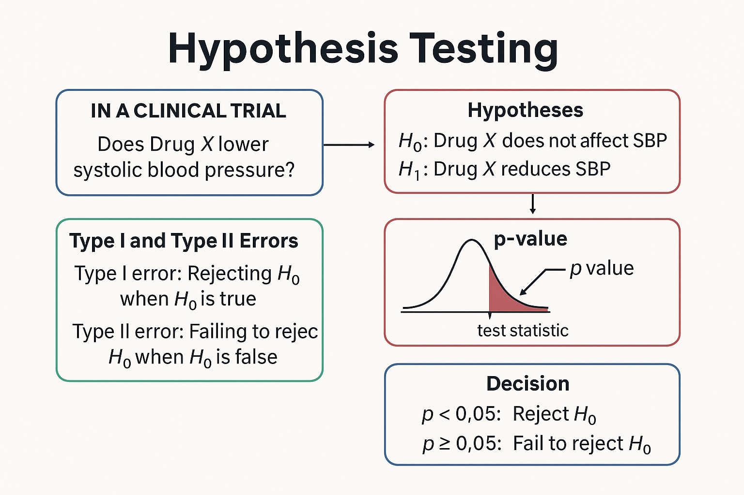

Slide 42
MCQ
A p-value of 0.03 means:
A) The result is not statistically significant
B) There is a 3% chance that H0 is true
C) There is a 3% chance of observing the result if H0 is true
D) The effect size is 3%
ANS: C
Notes:
Ans C

Slide 43
MCQ
Which of the following increases study power?
A) Reducing sample size
B) Increasing β
C) Increasing effect size
D) Increasing p-value
ANS: C
Notes:
Ans C

Slide 44
MCQ
Type II error occurs when:
A) We reject a true H0
B) We do not reject a false H0
C) We accept a false H1
D) The sample size is large
ANS: B
Notes:
Ans B

Slide 45
Thank You
Questions?

