Slide 1
Thesis Workshop for Junior Residents
Deriving Objectives and Defining Inclusion/Exclusion Criteria
Prof. Dr. Abhishek Pathak
Professor & HOD
Department of Psychiatry
HIMS, Sitapur

Slide 2
Objectives
Deriving Objectives
Difference between Research Question, Primary Objectives & Secondary Objectives
How to formulate Research Objectives
Defining Inclusion & Exclusion Criteria
Importance of Inclusion & Exclusion Criteria in Research
Common Errors & Pitfalls

Slide 3
Research Question/Research Hypothesis/Objectives
Research Question | How does low-intensity pulsed ultrasound (LIPUS) compare with a placebo device in managing the symptoms of skeletally mature patients with patellar tendinopathy?
Research Hypothesis | Pain levels are reduced in patients who receive daily active-LIPUS (treatment) for 12 weeks compared with individuals who receive inactive-LIPUS (placebo).
Objectives | To investigate the clinical efficacy of LIPUS in the management of patellar tendinopathy symptoms.

Slide 4
What are Objectives ?
Objectives specify what your study aims to achieve.
Types: - Primary Objective - Secondary Objectives

Slide 5
Examples of Objectives of a Study
Clinical Trial | Primary Objectives | Secondary Objectives
To determine the degree of hypotension of a new drug for induction of anaesthesia | To measure the fall in blood pressure after its administration and compare it with the fall/otherwise after administration of an agent in clinical use | Recording other adverse effects of the drug Duration of onset of action of the drug Interaction with other anaesthetic agents used
To study the antiemetic potential of a new agent | The occurrence of PONV with its use and compare it with the occurrence of PONV with a standard drug/placebo | To determine the duration of the effect of the agent Sedative effects of the agent Adverse effects of the drug

Slide 6
Examples of Outcomes of a Study
Clinical Trial | Primary Outcome | Secondary Outcome
To determine the degree of hypotension of a new drug for induction of anaesthesia | To determine whether a statistically significant reduction in blood pressure happened with the drug compared to a standard anaesthesia induction agent | Recording of rash along the venous path Events of cough after its administration
To study the antiemetic potential of a new agent | Whether a statistically significant reduction in the incidence of PONV was seen in the study population vis‑a‑vis the agent it was compared with | Higher incidence of postoperative hypoxaemia Hypotension after administration

Slide 7
Why are research objectives important?
Maintains the focus and direction of the research
Optimizes allocation of resources with minimal wastage
Saves time
Acts as a foundation for defining appropriate research questions and hypotheses
Provides measurable outcomes that can help evaluate the success of the research
Determines the feasibility of the research by helping to assess the availability of required resources
Ensures relevance of the study to the subject and its contribution to existing literature

Slide 8
Type of Research Objectives
Type of research objective | Definition
Exploratory | Explores a previously unstudied topic, issue, or phenomenon; aims to generate ideas or hypotheses
Descriptive | Describes the characteristics and features of a particular population or group
Explanatory | Explains the relationships between variables; seeks to identify cause-and-effect relationships
Predictive | Predicts future outcomes or events based on existing data samples or trends
Diagnostic | Identifies factors contributing to a particular problem
Comparative | Compares two or more groups or phenomena to identify similarities and differences
Historic | Examines past events and trends to understand their significance and impact

Slide 9
SMART Criteria for Research Objectives

Slide 10
How to write research objectives?
Brainstorming your objectives
State your main research question clearly and concisely.
Describe the ultimate goal of your study, which is similar to the research question but states the intended outcomes more definitively.
Divide this main goal into subcategories to develop your objectives.
Limit the number of objectives (1-2 general; 3-4 specific)
Assess each objective using the SMART

Slide 11
How to write research objectives?
Using the right language
Start each objective with an action verb like assess, compare, determine, evaluate, etc., which makes the research appear more actionable.
Use specific language without making the sentence data heavy.

Slide 12
How to write research objectives?
Writing the research objectives
The most common section to add the objectives is the introduction and after the problem statement.
Add the objectives to the abstract (if there is one).
State the general objective first, followed by the specific objectives.

Slide 14
Formulating research objectives
Identify the research problem.
Review past studies on subjects similar to your problem statement, that is, studies that use similar methods, variables, etc.
Identify the research gaps the current study should cover based on your literature review. These gaps could be theoretical, methodological, or conceptual.
Define the research question(s) based on the gaps identified.
Revise/relate the research problem based on the defined research question and the gaps identified. This is to confirm that there is an actual need for a study on the subject based on the gaps in literature.
Identify and write the general and specific objectives.
Incorporate the objectives into the study.

Slide 15
Take Home Message
Research objectives are concise statements that describe what the research is aiming to achieve.
They define the scope and direction of the research and maintain focus.
The objectives should be SMART—specific, measurable, achievable, realistic, and time-bound.
Clear research objectives help avoid collection of data or resources not required for the study.
Well-formulated specific objectives help develop the overall research methodology, including data collection, analysis, interpretation, and utilization.
Research objectives should cover all aspects of the problem statement in a coherent way.
They should be clearly stated using action verbs.

Slide 18
Basic Concepts
You want to know the Prevalence of Type-2 Diabetes Mellitus in 45 years- 75 Years old Males, who live in Ataria.
Target Population – Population of Ataria
Eligible Population – Type – 2 DM Males who are 45 to 75 years old living in Ataria.
Eligible Population is part of Target Population who fulfill certain eligibility criteria.

Slide 26
Important Aspects of Inclusion Criteria
They should be very specific.
Inclusion Criteria shouldn’t be too narrow.
Replication purposes
Researcher should be well informed about the criteria.
Notes:
If
your inclusion/exclusion criteria are too narrow, it will make it very difficult to identify subjects.
Criteria that are too narrow or specific cause two problems:
● Not enough participants, and
● Not enough data.
The more participants, the higher chance of obtaining significant results. If your pool of partici-
pants is too small, you will have less data and therefore the results will be less significant when
running statistical analyses such as t-tests. One reason to be specific is to control external or other
factors. Your criteria need to account for any possible interference with your study that could
come from outside the participant’s involvement. For example, if you have developed an appli-
cation that only works for Android users and not Apple users, be sure to state as an inclusion
criterion: “Participant must have an Android phone” instead of “Participant must have a cell
phone.” This would guarantee participants are able to use the application during your study. Another reason to be specific in your criteria is for replication purposes. Research continually
builds off of past research, and you should write your study protocol with that in mind. It is
imperative to be as clear as possible in order to:DESIGNING INCLUSION AND EXCLUSION CRITERIA
● Ease replication of the study for other researchers. Having other researchers
replicate your study further validates your results and adds more significance to
your findings.
● Increase the reliability of the results. The description of who can and cannot
participate guides the composition of the patient pool. If unclear criteria allow
the wrong subject to participate, the data can easily lose its reliability. t is also important to be clear so that every member of the research team understands the
criteria required of each potential participant. This is to make sure that researchers are aware
before and during the study in case at any point they notice something that could be of concern
to violating any criteria. The research team must be aware of the criteria because they are the
eyes and ears taking in the data and the participant experiences. This is especially important
during the time of recruitment to ensure only participants who are qualified for the study
comprise the subject pool

Slide 27
Steps for Determining Effective Criteria
Brainstorm as a team.
Look through key studies from your literature review.
Refer to valid sources for medical conditions to include/exclude.
Consider the arms of your study.
Look at past protocols.
Justify the reasoning behind each criterion.

Slide 28
Examples of Criterion Topics
Symptoms/diagnosis
Technology requirements
Medication
Education/Language Requirements
Demographics
Symptom contamination/comorbidities
Enrollment in other research studies

Slide 29
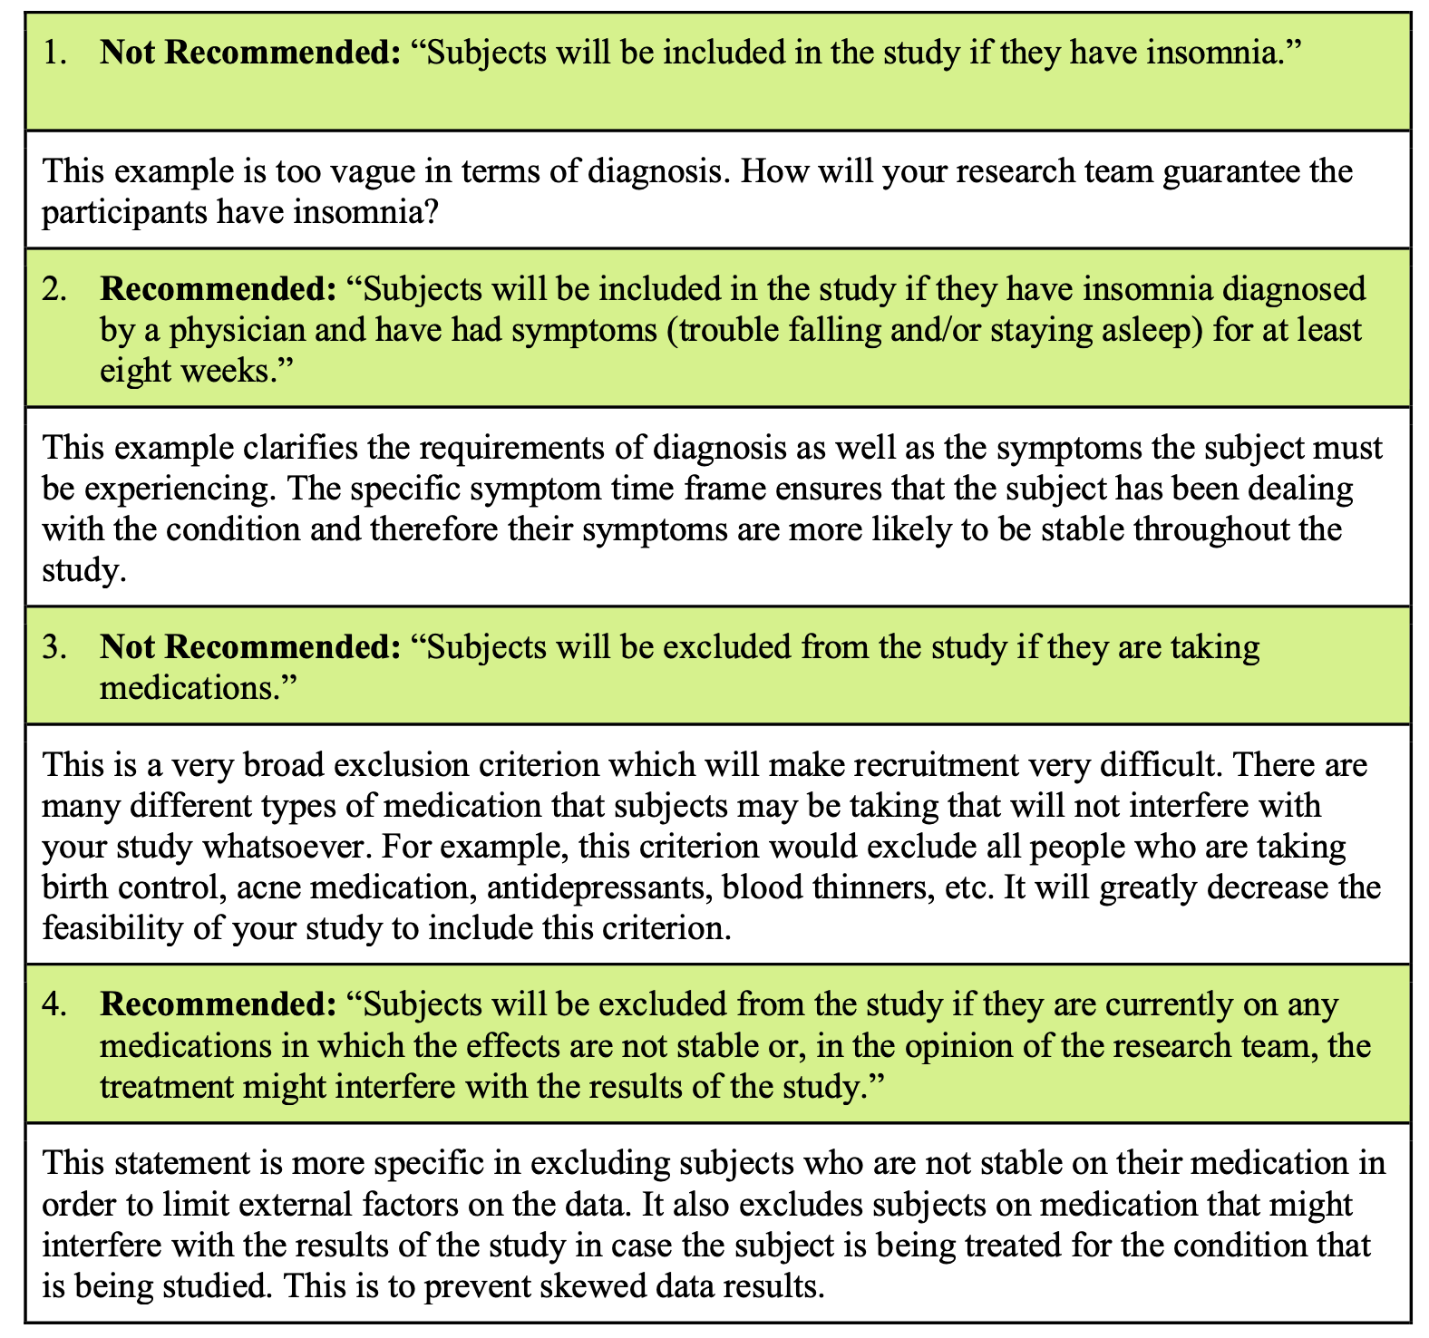

Slide 30
Notes:
Typical exclusion criteria can be:
Ethical considerations, such as being a minor or being unable to give informed consent
Practical considerations, such as not being able to read
If potential participants possess any additional characteristics that can affect the results, such as another medical condition or a pregnancy, these are also often grounds for exclusion.

Slide 33
Importance of Defining Inclusion & Exclusion Criteria
Helps researchers identify the study population in a consistent, reliable, and objective manner.
Study participants are more likely to have the attributes that will make it possible to robustly answer the research question.
Minimizes the likelihood of harming participants (e.g., excluding pregnant women) and safeguards vulnerable individuals from exploitation.
Influences generalizability of the study.
Notes:
eep in mind that researchers must be able to justify all inclusion and exclusion criteria added to their study. Unless the purpose of the research justifies the exclusion of a specific group, the research population should be as diverse as possible. The same goes for the risks and benefits associated with the study.
For example, in a study of prostate cancer, there would be no justification for excluding non-white men. But excluding cis-women is justifiable due to the target population in this case being “people with prostates.”
By applying inclusion and exclusion criteria to recruit participants, researchers can ensure that participants are indeed representative of the target population, ensuring external validity. Relatedly, defining robust inclusion and exclusion criteria strengthens your claim that causal relationships exist between your treatment and control groups, ensuring internal validity. Internal validity is the degree of confidence that the causal relationship you are testing is not influenced by other factors or variables.
External validity is the extent to which your results can be generalized to other contexts.

Slide 34
Common errors regarding inclusion and exclusion criteria
Using the same variable to define both inclusion and exclusion criteria.
Selecting variables as inclusion criteria that are not related to answering the research question.
Not describing key variables in the inclusion criteria that are needed to make a statement about the external validity of the study results.

Slide 35
IMPACT OF THE INCLUSION AND EXCLUSION CRITERIA ON THE EXTERNAL VALIDITY OF THE STUDY

Slide 40
Interactive Case Exercise
🧪 Case:
A 34-year-old male with Alcohol Dependence Syndrome (ADS) is admitted for detoxification.
You want to study predictors of complicated alcohol withdrawal.
👉 Task for Groups:
1. Derive a primary objective
2. Frame two secondary objectives
3. Suggest 3 inclusion and 3 exclusion criteria

